Slide 1

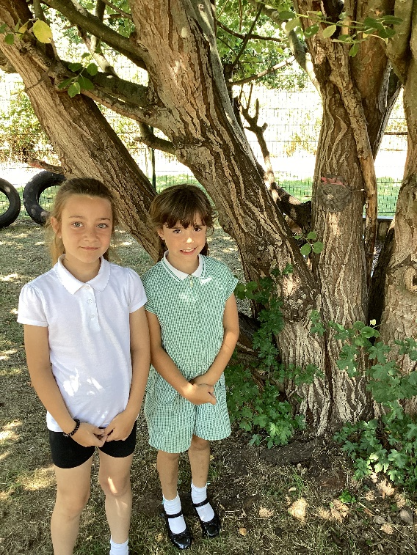
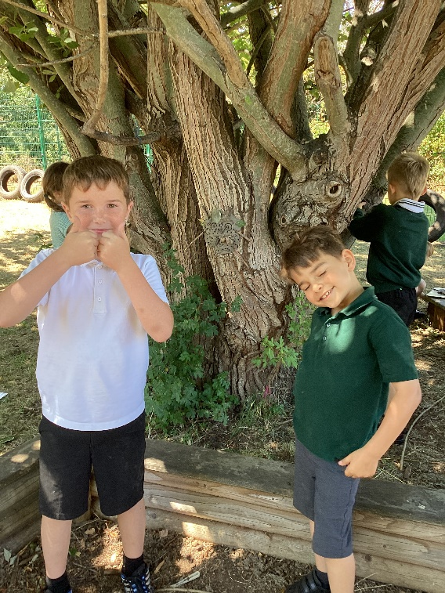
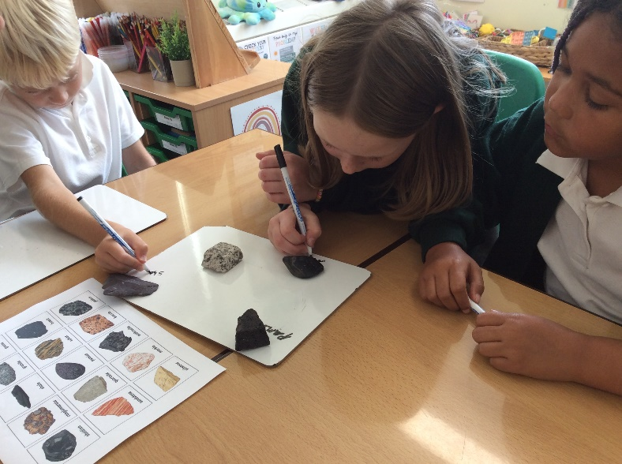
Willow Class Welcome Meeting 2025/26

Slide 2
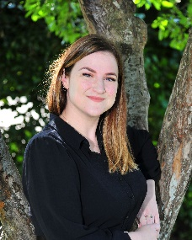
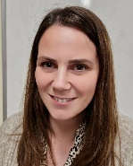
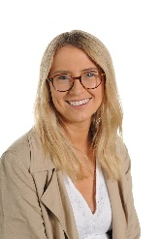
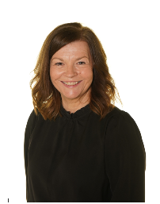
Willow Class Team
Mrs Luton
Class Teacher
(Mon – Wed)
Miss Arnold
Class TA
(Mon/Fri)
Miss Kelly
Class Teacher (Thurs - Fri)
Mrs Williams
Class TA and PPA cover

Slide 3

School Rules
Be Safe
Be gentle and kind
Be co-operative and helpful
Be respectful of others and ourselves
Be responsible
Be honest
Be polite

Slide 4

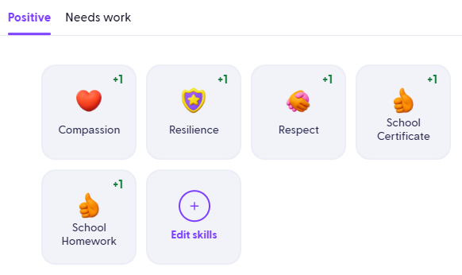
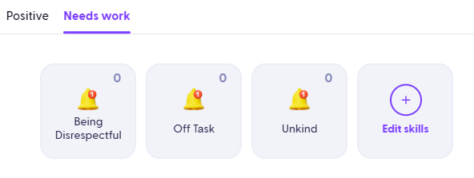
House Points
(Dojos)
Our school behaviour principles and rules remain the same
The behaviour ladder has been removed to reduce the visual element
This change helps avoid feelings of shame for some children
Green Dojos (house points) are awarded for positive choices and go towards each child’s individual house
Both green and red Dojos are monitored closely by staff
A reflection book is used after poor behavioural choices to help children understand the real-life consequences of their actions
Repeated poor choices lead to a check-in with a member of SLT
Future aim: share Dojos with parents once a consistent approach across all staff is in place

Slide 5
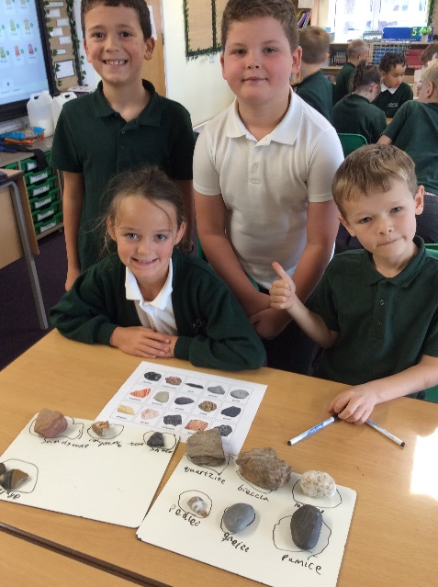
A typical day in Willow class
Phonics/Spellings
Maths lesson
Assembly
Times Tables
English
Reading
Learning Enquiry/Art/Science
Children will have a core seating plan that will be reviewed regularly and rotate each half term.
PE LESSONS ON TUESDAY (SKILLS BASED) AND FRIDAY (GAMES/APPLICATION OF SKILL)

Slide 6

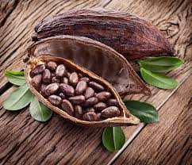
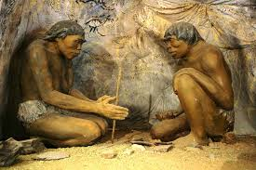
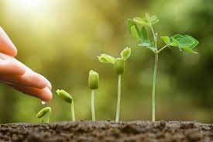
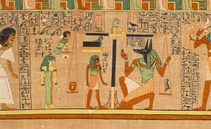
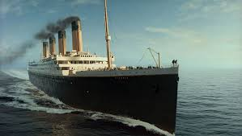
Willow Class Learning Enquiry
1. How did life change for people during the Stone Age?
2. Where does chocolate come from?
3. How did things change after the sinking of The Titanic?
4. What was life like for the Ancient Egyptians?
5. How do plants grow most effectively?
6. Will England ‘Bring it home’?

Slide 7

Reading
In school:
Reading lessons take place for 30 minutes every day. In year 3, there will be two different types of reading lesson:
    READING FLUENCY Children will build up their pace (increase words read per minute). A short extract is read multiple times within one lesson).
    EXTENDED READ As a class, we will share a longer book (usually across a full term). The children will build up reading stamina. Comprehension will be developed through pre-planned questions.
At home:
4 times a week - to be recorded in reading record.
Check Friday – Recorded in records. Rewards for effort.
Any reading activity can be recorded (own books)

Slide 8


Slide 9
Writing
Writing for a purpose – Entertain, Inform, Discuss, Persuade
Consolidating key skills (from previous year group to begin with)
Try, use, prove sequence.
Daily phonics teaching until Christmas then 3 x weekly spelling lessons where spelling rules will be taught.
Handwriting practise weekly – children will be encouraged to join.

Slide 10

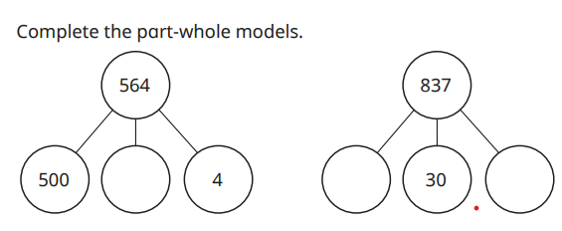
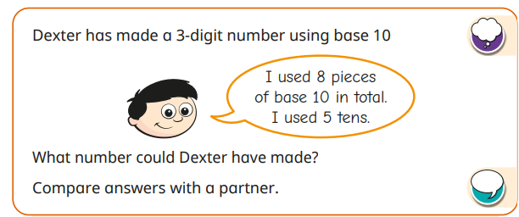
Maths
In school
Mini quiz to assess at start of new unit
Learn, use, explore sequence
Arithmetic lessons (place value, calculation, times tables tests)
Daily multiplication practice

Slide 11




Maths Home Learning
Maths learning at home should be completed 4 times weekly.
This will be recorded in the Reading/Maths Home Learning Book.
4 x Maths Learning a week = 1 House point
This could be timetables, money, telling the time etc
List of websites:
www.mathsframe.co.uk
www.ttrockstars.com
www.numbots.com
www.maths.co.uk - set by teachers.
Why do Maths Home Learning?
Completing Maths homework consistently will support your child to practise and get better at skills they’re learning in class
It will also reinforce skills that the they may need extra support in.
This will support their fluency in maths learning at home and give them nearly an extra hour of learning time every week for maths.

Slide 12
How Parents Can Help
Reading –
Read to your child, share stories, encourage reading for pleasure, join a library, read books that are enjoyable.
Encourage reading with expression and comprehension (answering questions in full sentences).
Maths -
Help children apply their maths skills (handling money and giving change, telling the time, measuring and solving real life problems, time tables)
Continue to practise times tables.

Slide 13
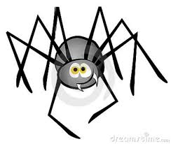

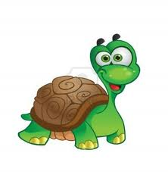




Learning Styles - ‘ELLI’
I can make links in my learning.
I can change and adapt my learning to make it better.
I keep going and don’t give up!
I am creative in my learning.
I am curious and I like to ask questions.
I can plan ahead to help my learning.
I can work with others and on my own sensibly.

Slide 14
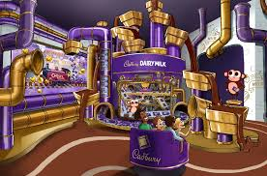
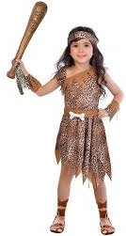
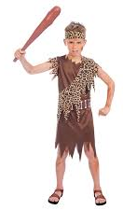

CLASS TRIPS/THEME DAYS
(the exciting part)
TERM 2 – CADBURY WORLD
Late Nov – info to follow
TERM 1 – STONE AGE DAY
(in school) Thursday 9th October
TERM 6 – INTERNATIONAL DAY
(in school)

Slide 15


