Slide 1

Welcome to Pine Class

Slide 2

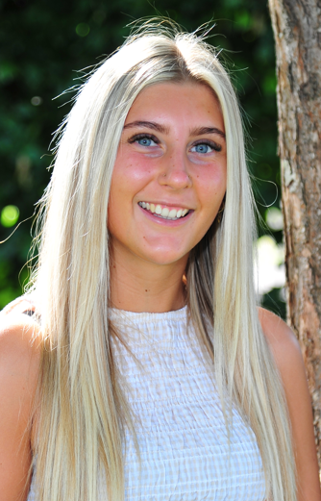
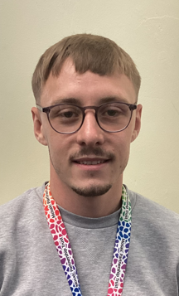
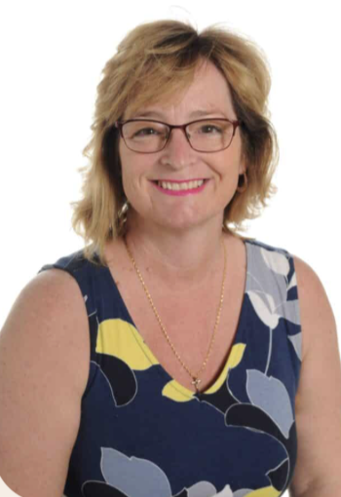
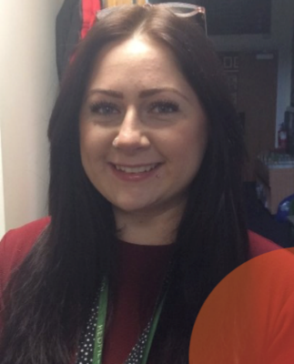
Meet The Team
Miss Cole
Class Teacher
Monday-Friday
Mr Davis
(1:1 support)
Teaching Assistant Monday morning, Tuesday-friday
Mrs Noad
(PPA/ECT Cover)
HLTA Teaching Assistant
Tuesday afternoon, Wednesday morning
Miss Day
(ELSA and teaching assistant)
Monday-Thursday mornings

Slide 3
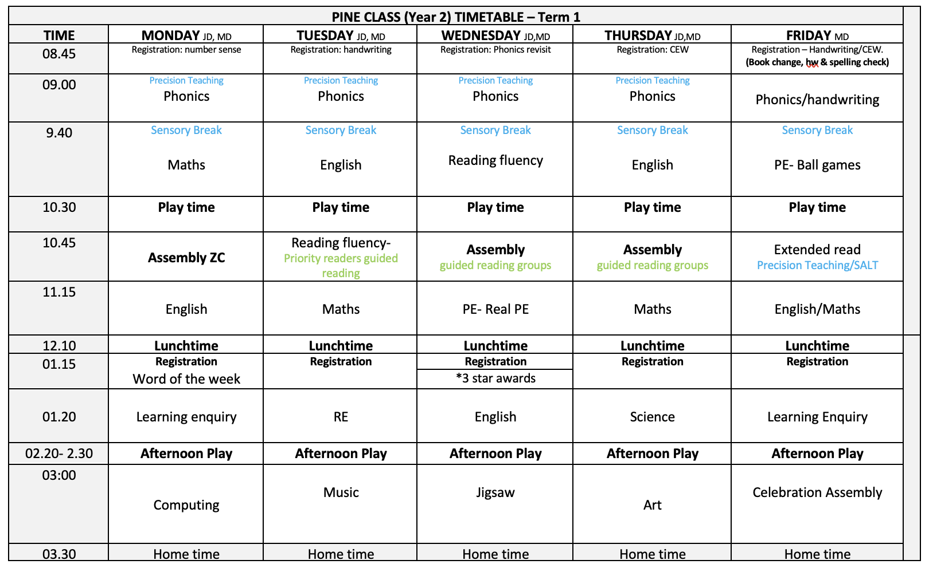
Routines in Pine class?
Phonics 4x a week
English lesson
Maths lesson
Reading lesson
Learning enquiry
Also includes additional interventions/flexible resources for all individuals within the class

Slide 4
Playtimes and lunchtimes:
Morning Playtime 10:30- 10:45
Children have the choice of a healthy snack ie. fruit, cereal bars
They can also have toast and milk which is paid on ARBOR in advance
Lunchtime 12:15- 1:15
Children go into the hall at 12:15 and eat either packed lunch from home or a school hot dinner- please check the menus each day for allergen advice.
When they finish eating, they go outside and play until 1:15
Afternoon Playtime 2:20- 2:30
Children are offered fruit from the classroom or additionally adults can provide an additional healthy snack

Slide 5
Physical Education:
PE days are: Wednesday and Friday mornings
Please ensure your child has a full kit bought into school, This must be Named and kept in school for the term!
PE Kit:
House colour top and black shorts.
White trainers or black daps and socks.
Children may wear a jumper and trousers when it is cold/rainy, but these must also be black.

Slide 6


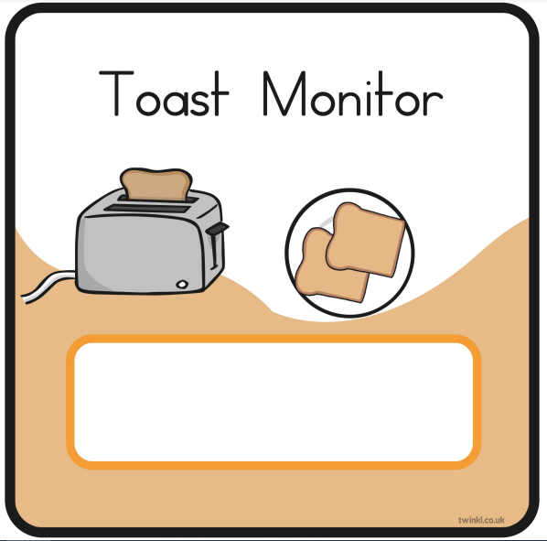


Becoming independent:
Please name your child’s water bottles, jumpers, cardigans ect

Slide 7







Teaching and Learning
Children need to learn how to learn!
We will be continuing to encourage the children to develop the following skills:
Owl
Strategic Planning
Spider
Links in Learning
Chameleon
Changing Learning
Bee
Team Work
Cat
Curiosity and
Questioning
Unicorn
Creativity
Tortoise
Resilience

Slide 8
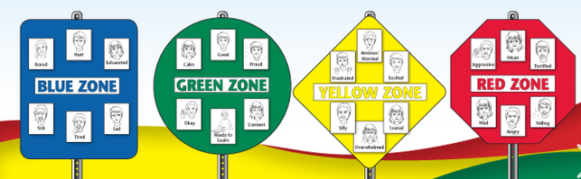
Mental Health and Wellbeing
Large focus in Term 1
Zones of regulation- teaching children to recognize emotions
Providing useful tools and support to help children regulate/ feel ready to learn
Mental health ambassadors
Sensory room

Slide 9

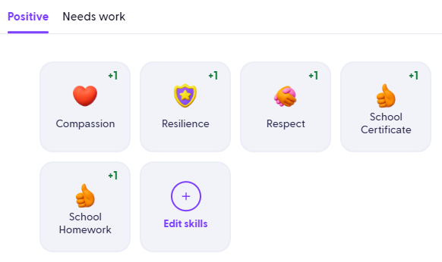
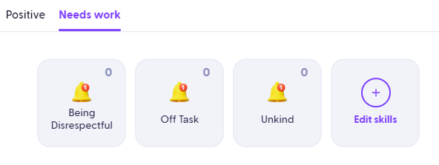

House Points
(Dojos)
Our school behaviour principles and rules remain the same
The behaviour ladder has been removed to reduce the visual element
This change helps avoid feelings of shame for some children
Green Dojos (house points) are awarded for positive choices and go towards each child’s individual house
Both green and red Dojos are monitored closely by staff
A reflection book is after poor behavioural choices to help children understand the real-life consequences of their actions
Repeated poor choices lead to a check-in with a member of SLT
Future aim: share Dojos with parents once a consistent approach across all staff is in place

Slide 10
Class Topics
Term 1: What was life like in a castle?
Term 2: Who was Florence Nightingale and why is she important today?
Term 3: Where in the world would you go?
Term 4: What happened during the Great Fire of London?
Term 5: What’s at the bottom of your garden?
Term 6: Do you like to be beside the Seaside?

Slide 11
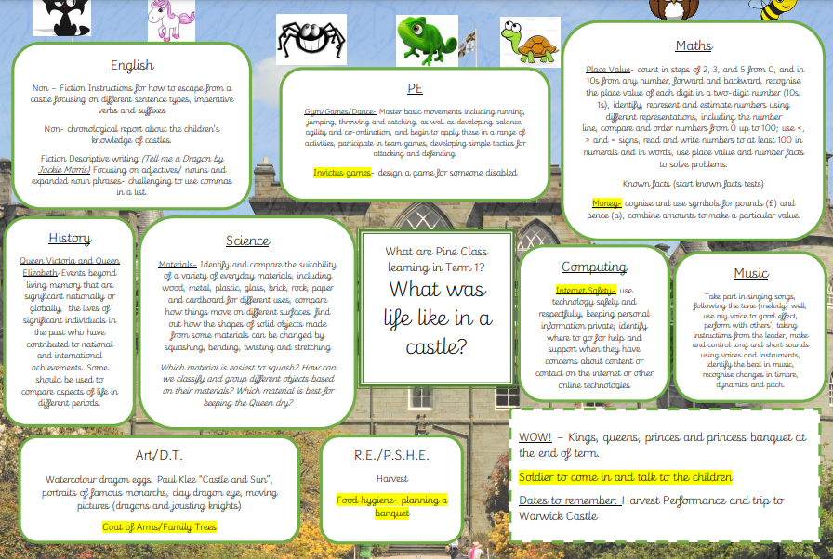
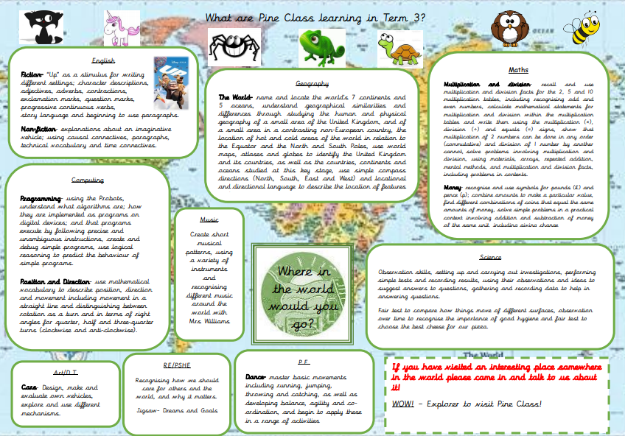
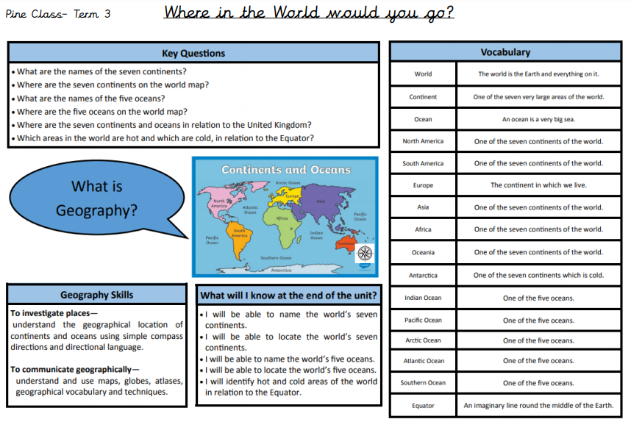
Curriculum Maps and Knowledge Organiser

Slide 12
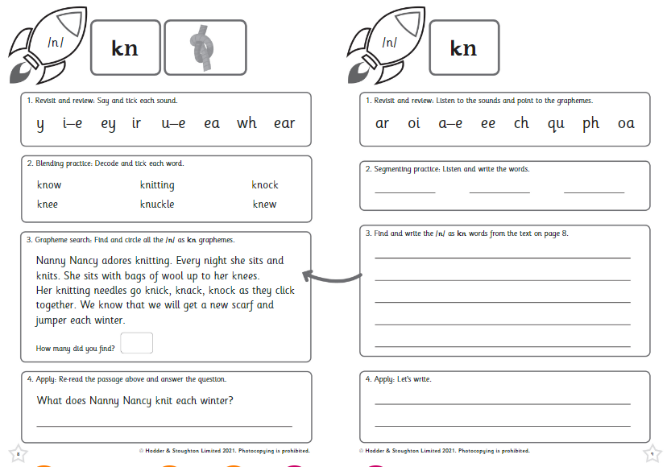
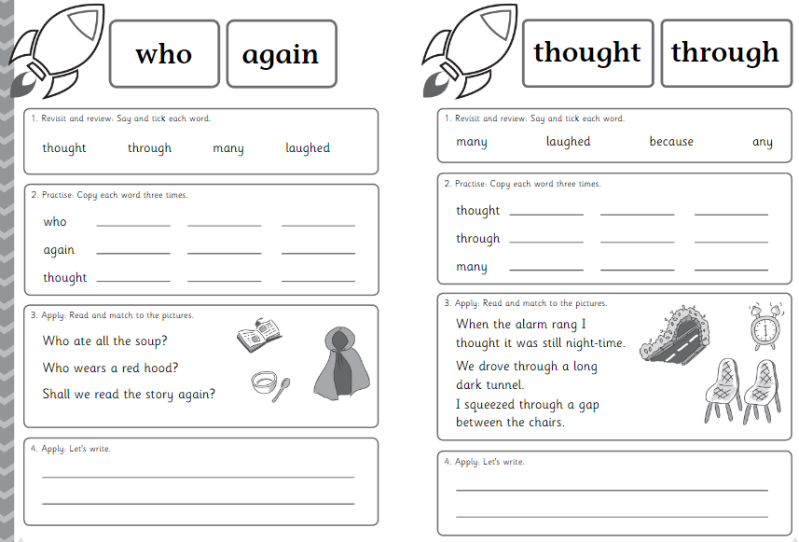
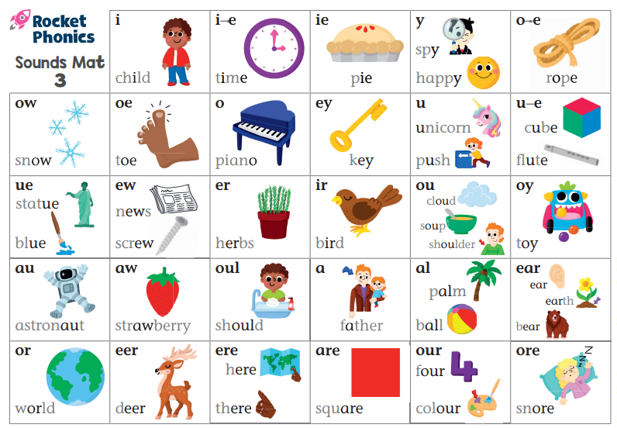
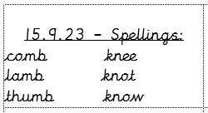
Phonics and Spellings

Slide 13
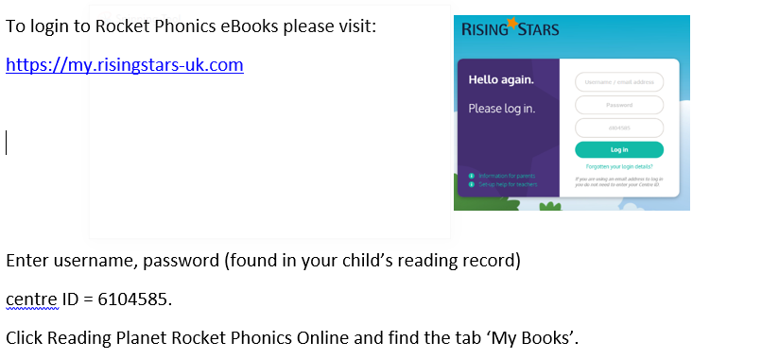

Rocket Phonics eBooks

Slide 14

Reading in school
Reading Fluency lessons x4
Focus on increasing speed and accuracy of reading
Introduce new ambitious vocabulary, increase prosody skills & ability
Term 2 expectation for Year 2 is reading 60 words per minute
Extended read lessons x1
Whole class read with focus on comprehension VIPERS style questions: Vocabulary, Inference, Predict, Explain, Retrieve and sequence
Helps children to understand what they have read
Priority readers/ Guided reading groups
Children that need extra support with reading will be listened to by the class teacher or another member of staff during the week. Children will also do group guided reading sessions to help with comprehension skills.
Reading for Pleasure
Children are encouraged to read for pleasure and are given opportunities throughout the week to choose a book from the book corner/ library to read.
A select few children will be listened to. These are children who need extra support in reading comprehension.

Slide 15
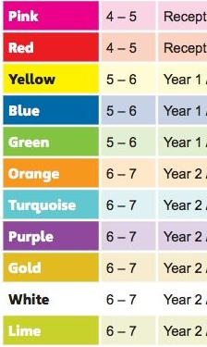
Reading at home
Every child should be reading a school reading book at least 4 times a week at home
Coloured Book Bands
Your child will have 2 books on the colour they are reading.
These books can be changed on a Friday but I suggest children read the book at least twice before changing.
They are also allowed to read books from home and this can be recorded in their Reading Record Book.
If they read 4 times they earn a house point.

Slide 16


Maths at home
Number Bonds and Times Tables
Practise 4 times a week.
This can be on Numbots, TT Rockstars or on paper either with an adult/seen by an adult.
Activity must be recorded in home learning record.
This will support their fluency in maths learning at home and give them an extra hour of learning time every week for maths.
Log ins have been put in their reading records

Slide 17
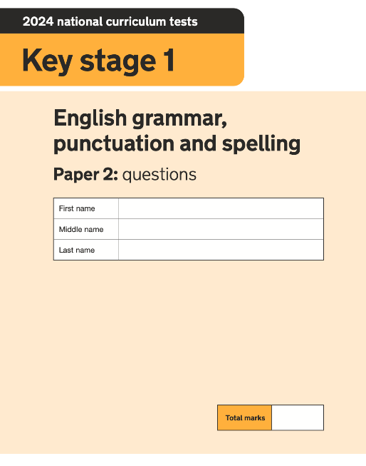
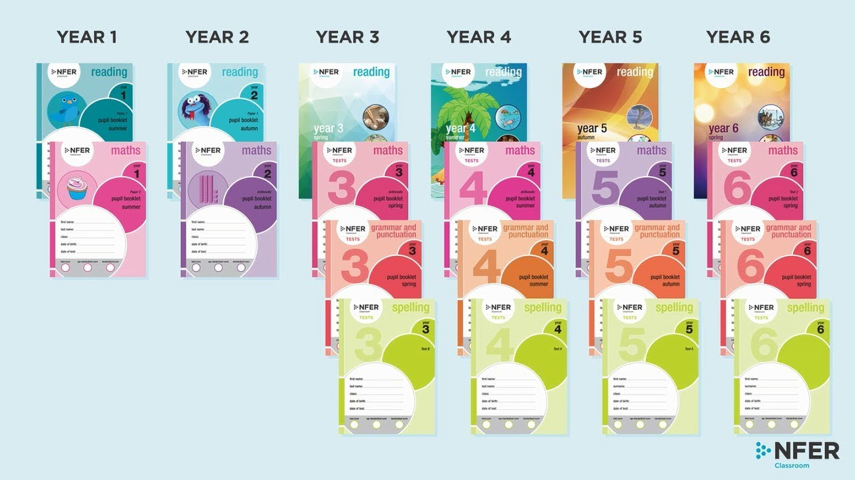
Assessments
Children are assessed Terms 2, 4 and 6 to monitor progress throughout the year. These are NFER papers or past SATS papers
If you wish to view SATS papers access the link: https://www.gov.uk/government/publications/optional-key-stage-1-tests-2024-english-grammar-punctuation-and-spelling-test-materials
Additional reading fluency tests are given to determine your child’s book bands (termly)

Slide 18
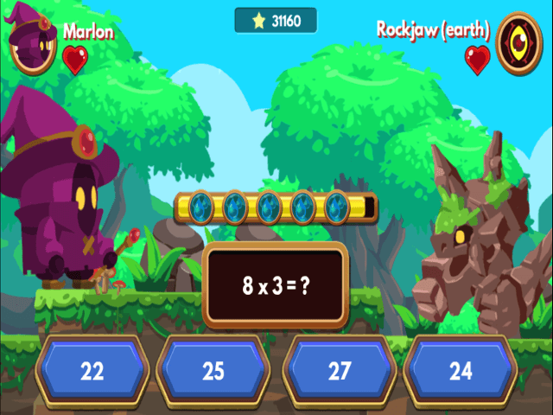

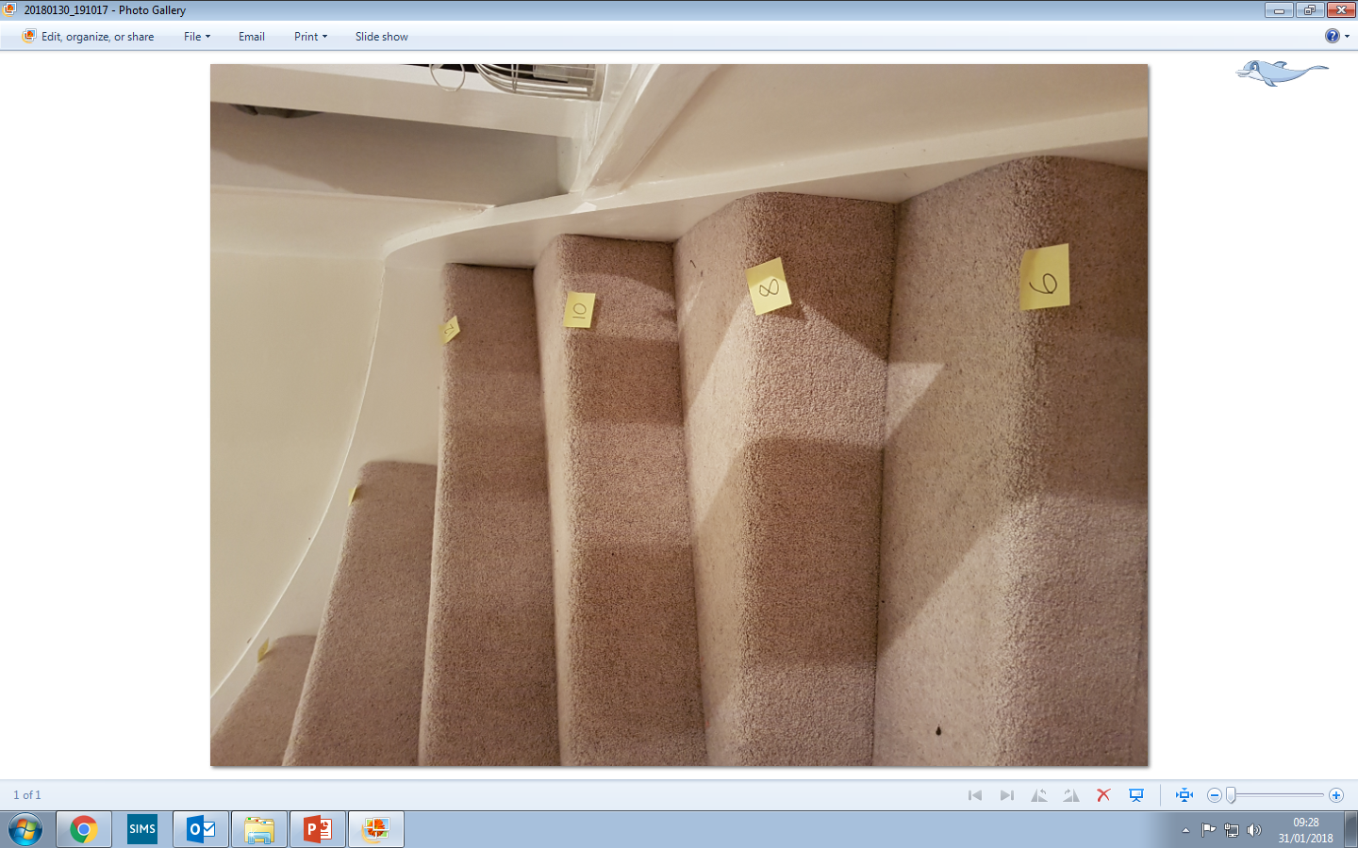
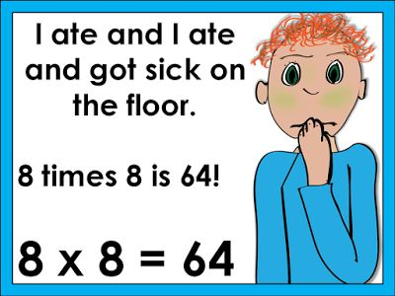

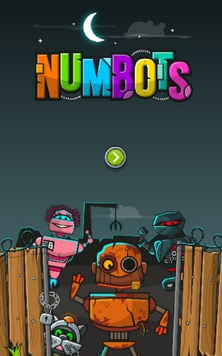
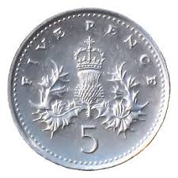
How can you help at home?
Maths Frame
Top Marks
TT Rock Stars
Numbots
Musical Maths
Activity Booklets
Rhymes
Counting in 2s, 5s and 10s

