Slide 1
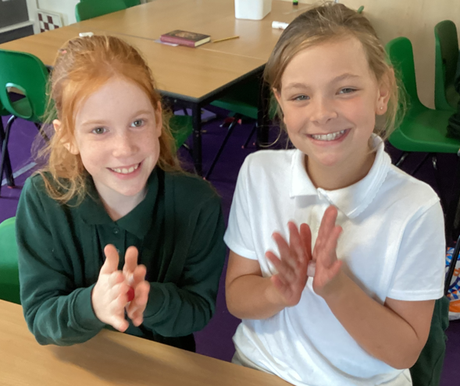
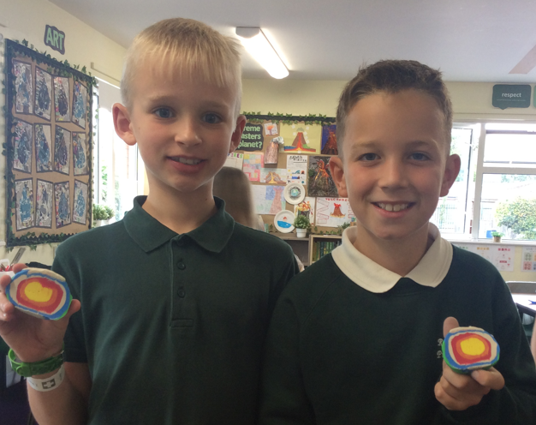
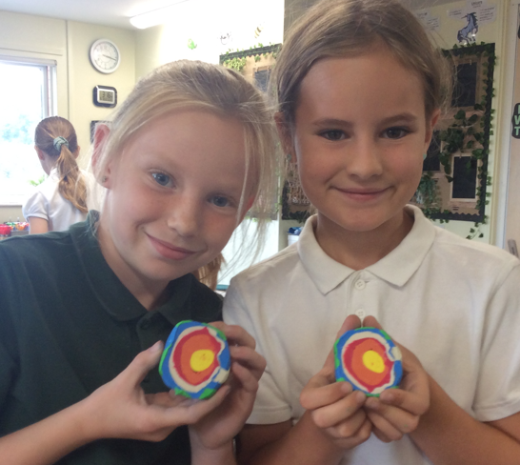
Maple Class Welcome Meeting 2025/26

Slide 2

Mosaic Partnership Trust
We have now been part of the Mosaic Partnership Trust for just over a year now and will be working closely with 11 others schools
on a number of exciting projects to improve our provision here at Redfield Edge.
Networks for leaders in school (HT, DHT, SENDCO)
Networks for subject leaders
Joint training for all staff
Shared resources
Shared expertise
Opportunities for children – sports competitions, music…
Barrs Court Primary
The Park
Parkwall
Ridgeway
Gillingstool Primary
St Michaels Primary
Raysfield Primary
Neston
Box
St Stephen’s Juniors

Slide 3


Behaviour at Redfield Edge
All Mosaic Partnership Trust schools should:
encourage children to treat others as they would want to be treated, with respect and appreciation of difference and diversity
celebrate and reward positive choices of behaviour
provide a safe, secure, reflective and happy environment
believe every individual in the school community needs to take responsibility for their own actions
support through help, encouragement and positive modelling of expectations
accept that mistakes are part of the learning process
respect differences, whether it be race, gender, age, sexuality, religion, disability, socio-economic background or other protected characteristics
value each individual opinion
have a positive atmosphere and 'ethos'.

Slide 4

School Rules
Be Safe
Be gentle and kind
Be co-operative and helpful
Be respectful of others and ourselves
Be responsible
Be honest
Be polite

Slide 5

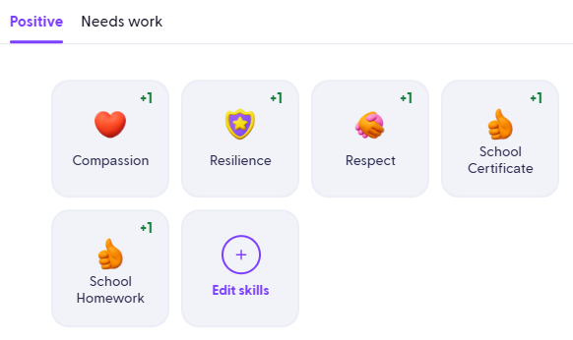
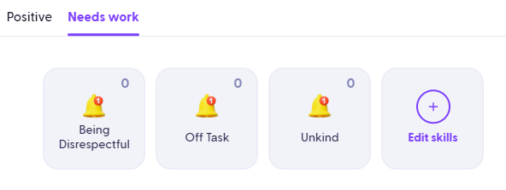
House Points
(Dojos)
Our school behaviour principles and rules remain the same
The behaviour ladder has been removed to reduce the visual element
This change helps avoid feelings of shame for some children
Green Dojos (house points) are awarded for positive choices and go towards each child’s individual house
Both green and red Dojos are monitored closely by staff
A reflection book is after poor behavioural choices to help children understand the real-life consequences of their actions
Repeated poor choices lead to a check-in with a member of SLT
Future aim: share Dojos with parents once a consistent approach across all staff is in place

Slide 6
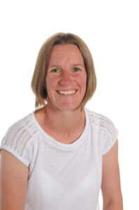
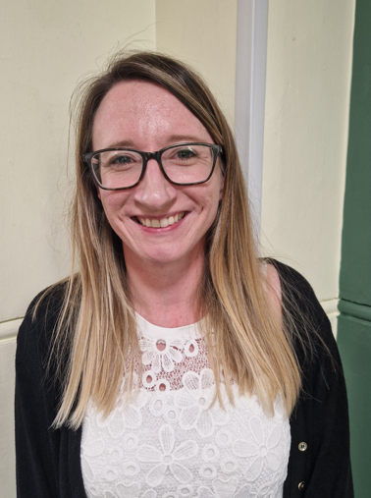
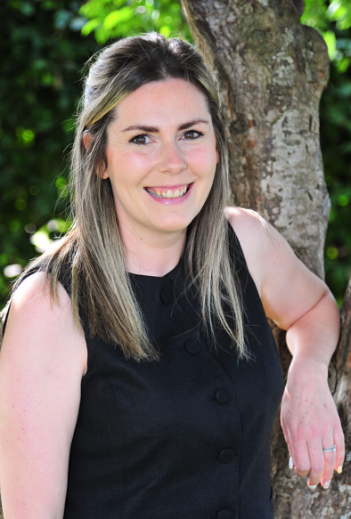
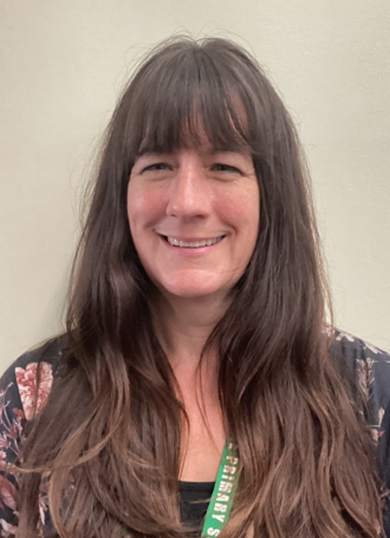
Maple Class Team
Mrs Barnes
Class Teacher
(Mon – Tue)
Mrs Griffiths Class Teacher (Wed - Fri)
Mrs Stone Class TA
Mrs Davies
PPA

Slide 7
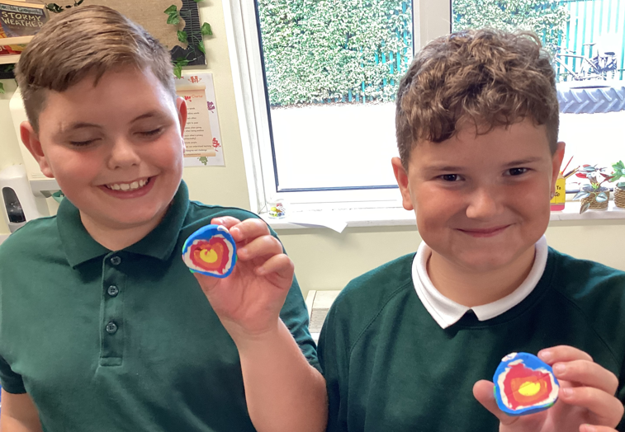
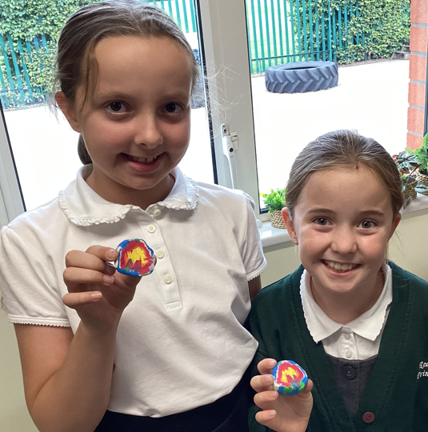
A typical day in Maple Class
Spellings
Times tables / MathsBots
English lesson
Maths lesson
Reading
Learning Enquiry
FLEXIBLE GROUPINGS/RESOURCES TO SUPPORT LEARNING IN A VARIETY OF WAYS

Slide 8
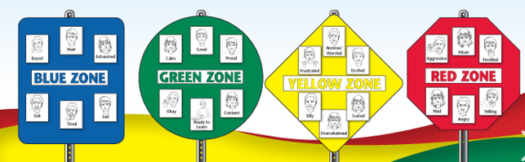
Zones of Regulation
- How are the children feeling?
Recognising their own triggers and learning strategies and ‘tools’
Reflecting on a situation
Support understanding of others

Slide 9
Maple Class Learning Enquiry (topic)
1. How can extreme natural disasters and weather affect the earth ?
2. How did life change for children during the Victorian Period? What impact did Brunel have on life in the Victorian Era?
3. How has equality been promoted across the world?
4. How have the Anglo Saxons impacted Modern Day society?
5. What impact did ancient Greeks have on modern life ?
6. Why are Rainforests so important and why is it important to protect them ?

Slide 10



Reading
In school:
Fluency Reading
Extended Read
Close Read
Termly Class text (extended read)
Picture book for English lessons
At home:
4 times a week - to be recorded in reading record. See handout.
Check Friday – Recorded in records. Rewards for effort.
Any reading activity can be recorded (own books, Nessy)

Slide 11
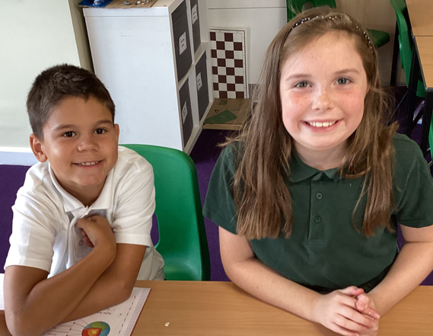
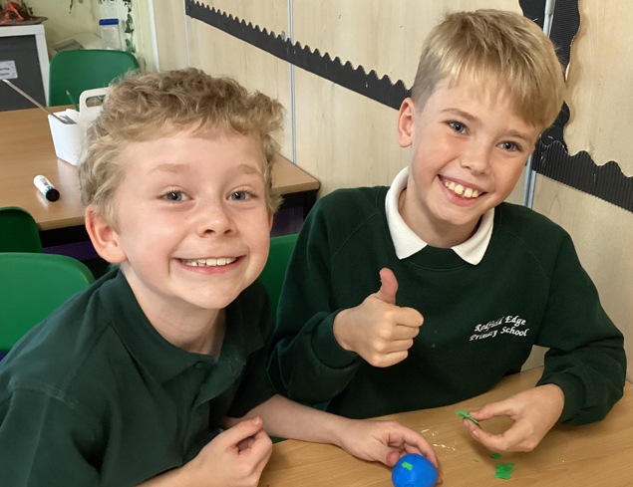
Writing
Writing for a purpose – Entertain, Inform, Discuss, Persuade
Consolidating key skills (from previous year group to begin with)
Teaching Year 5 SPAG
Try, use, prove sequence.
3 spellings lessons weekly (spelling rules, keywords).
Handwriting practise weekly (may be part of a spelling lesson - cursive).

Slide 12
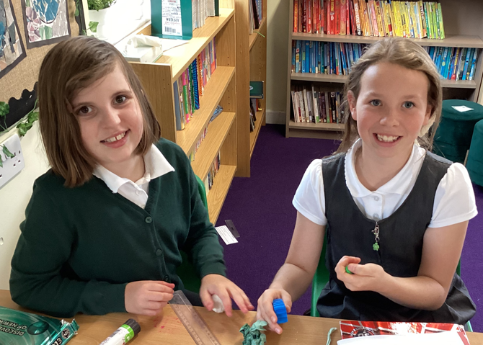
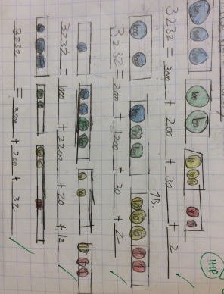
Maths
In school
Mini quiz to assess at start of new unit
Learn, use, explore sequence
Arithmetic lessons (place value, calculation, times tables tests)
Resources used to support learning

Slide 13
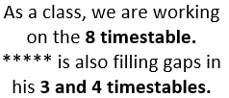





Maths Home Learning
Maths learning at home should be completed 4 times weekly.
This will be recorded in the Reading/Maths Home Learning Book.
4 x Maths Learning a week = 1 House point
This could be timetables, money, telling the time etc
List of websites:
www.mathsframe.co.uk
www.ttrockstars.com
www.numbots.com
www.maths.co.uk - set by teachers.
Why do Maths Home Learning?
Completing Maths homework consistently will support your child to practise and get better at skills they’re learning in class
It will also reinforce skills that the they may need extra support in.
This will support their fluency in maths learning at home and give them nearly an extra hour of learning time every week for maths.

Slide 14
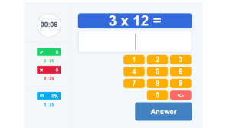
Multiplication Tables Check (MTC)
The multiplication tables check (MTC) is statutory for all year 4 pupils in England.
The purpose of the MTC is to determine whether pupils can recall their times tables fluently, which is essential for future success in mathematics
They are tested on their multiplication tables up to 12 x 12. There are twenty-five questions and children have six seconds to answer each question and three seconds between questions.

Slide 15
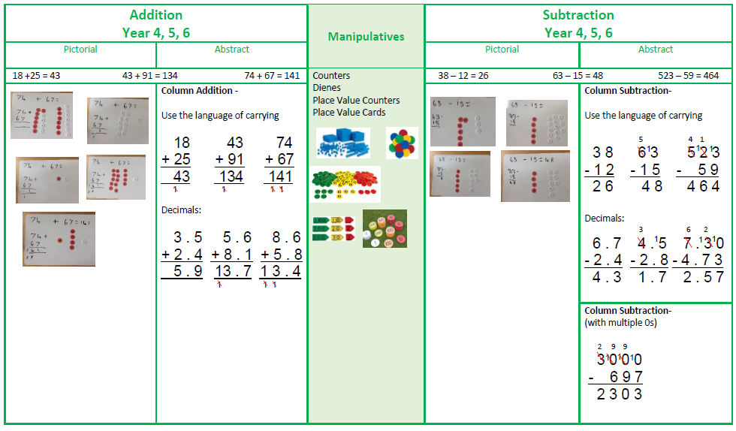
Maths
School calculation policy – if helping/supporting your child at home, where possible we would encourage using the same methods to ensure continuity in the use of their methods.

Slide 16
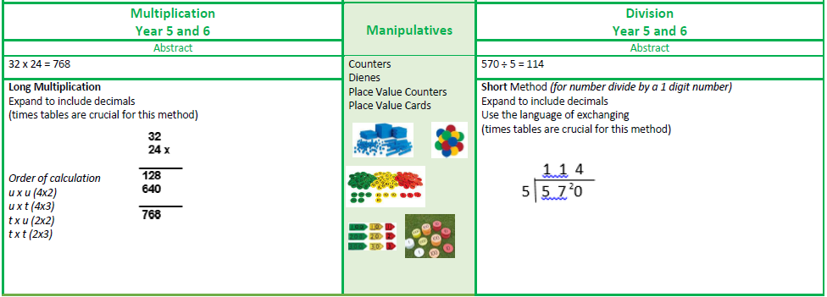
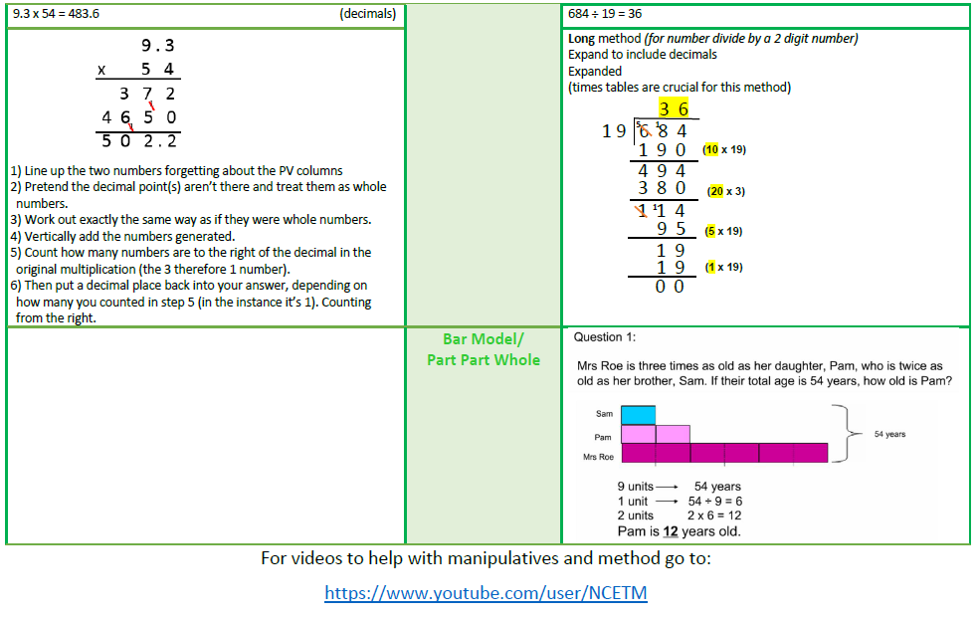

Slide 17







Learning Styles - ‘ELLI’
I can make links in my learning.
I can change and adapt my learning to make it better.
I keep going and don’t give up!
I am creative in my learning.
I am curious and I like to ask questions.
I can plan ahead to help my learning.
I can work with others and on my own sensibly.

Slide 18
How Parents Can Help
Reading –
Read to your child, share stories, encourage reading for pleasure, join a library, read books that are enjoyable.
Encourage reading with expression and comprehension (answering questions in full sentences).
Maths -
Help children apply their maths skills (handling money and giving change, telling the time, measuring and solving real life problems, time tables)
Continue to practise times tables.
English -
Weekly spelling activity linked to classroom learning.
Continue to practice Year group spellings.

Slide 19

Other Information
Water bottles
Bathroom visits
P.E – Monday (but does change termly)
Open classrooms – scheduled throughout the year
Extra-curricular clubs
Parents’ Evening 11th or 12th November (including SEND)
SEND Parents’ Evening 6th and 7th January
Class assembly 29th January and 5th March
Camp….

Slide 20

Questions- If you have any queries/concerns/questions at any point during the year, please let us know!!
Enquiries@redfieldedgeprimary.co.uk
Keep up to date with events/learning in the…..

Slide 21


