Slide 1

Welcome to
Hazel Class
Year 1

Slide 2
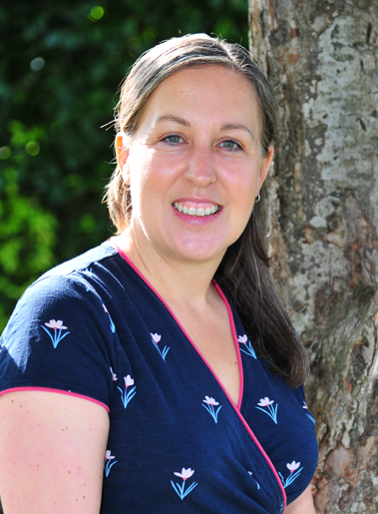
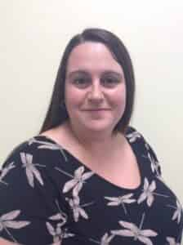
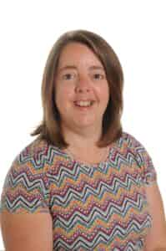
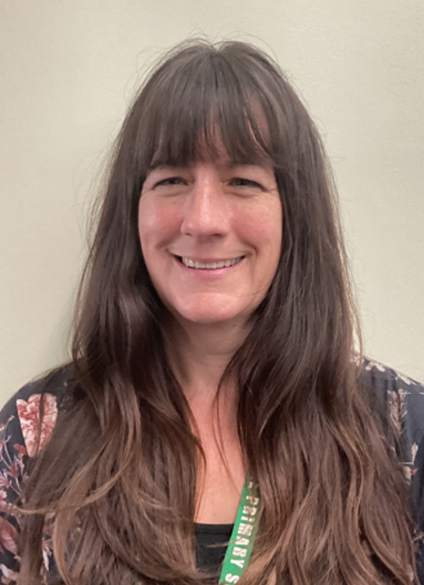
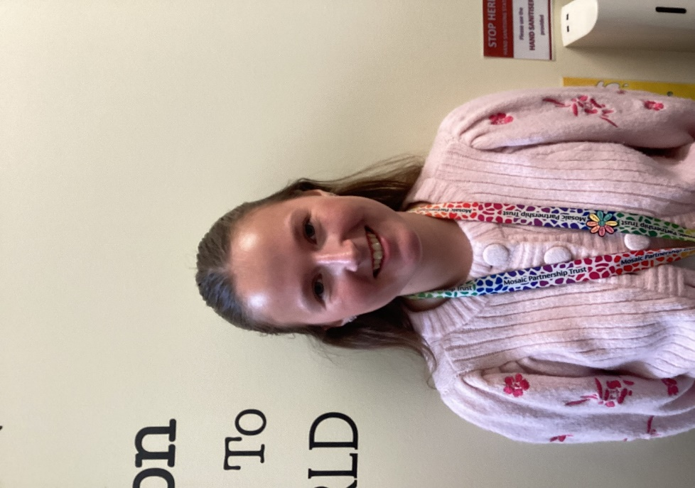
Meet The Team
Mrs Stiby
Class teacher
Miss Cottrell
Teaching Assistant
Breakfast Club
Mrs Bailey
Teaching Assistant
Miss Smart
Teaching Assistant Apprentice
After School Club
Mrs Davies
PPA
Tuesday afternoons

Slide 3
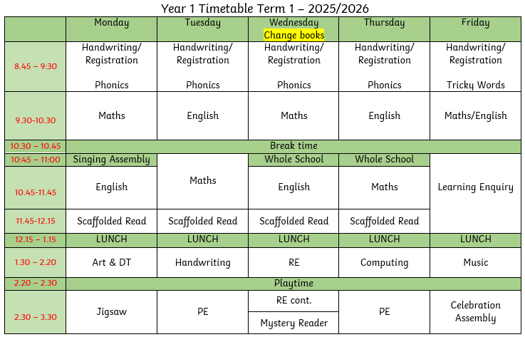
Routine

Slide 4



Playtime and Lunchtime
Morning Playtime 10:30 - 10:45
Healthy snack from home
Fruit (free)
Toast (paid for in advance)
Milk (paid for in advance).
Lunchtime 12:15 - 1:15
Children go into the hall at 12:15 to eat their packed lunch or hot dinner (booked in advance).
When the children finish eating, they go outside and play until 1:15.
Afternoons 2:20 - 3:30
Children are offered fruit (free).

Slide 5

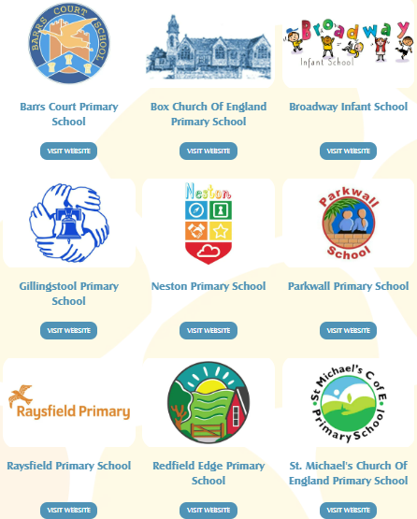

Mosaic Partnership Trust
We are part of the Mosaic Partnership Trust and work closely with 11 other schools.
Networks for leaders in school
Joint training for all staff
Shared resources
Shared expertise
Opportunities for children – sports competitions, music…

Slide 6

Behaviour at Redfield Edge
All Mosaic Partnership Trust schools should:
encourage children to treat others as they would want to be treated, with respect and appreciation of difference and diversity
celebrate and reward positive choices of behaviour
provide a safe, secure, reflective and happy environment
believe every individual in the school community needs to take responsibility for their own actions
support through help, encouragement and positive modelling of expectations
accept that mistakes are part of the learning process
respect differences, whether it be race, gender, age, sexuality, religion, disability, socio-economic background or other protected characteristics
value each individual opinion
have a positive atmosphere and 'ethos'.

Slide 7

School Rules
Be Safe
Be gentle and kind
Be co-operative and helpful
Be respectful of others and ourselves
Be responsible
Be honest
Be polite

Slide 8

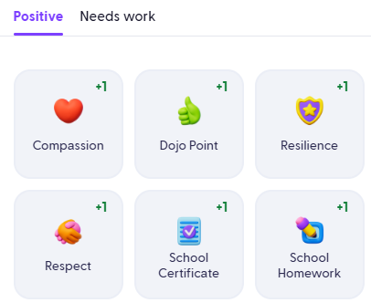
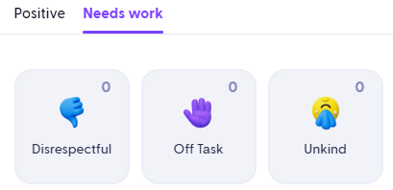
House Points
(Dojos)
Our school behaviour principles and rules remain the same
The behaviour ladder has been removed to reduce the visual element and any feelings of shame for some children
Green Dojos (house points) are awarded for positive choices and go towards each child’s individual house
Both green and red Dojos are monitored closely by staff
A reflection book is used to support restorative conversations following poor behavioural choices to help children understand the consequences of their actions
Repeated poor choices lead to a check-in with a member of SLT
Future aim: share Dojos with parents once a consistent approach across all staff is in place

Slide 9

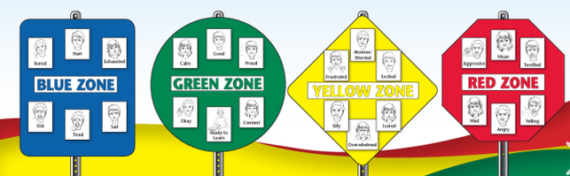
Wellbeing
Zones of Regulation
Mindfulness Pod
Mental Health Ambassadors
Hello Yellow
Sensory Room

Slide 10
Learning Enquiries
Term 1: What makes me Super?
Term 2: How did Dinosaurs become Extinct?
Term 3: What Toys did children play with in the past?
Term 4: Which Planet do we live on?
Term 5: How does your garden grow?
Term 6: Where in the world is Africa?
T1- Superhero Day, School Nurse Visit
T2- KS1 Nativity
T3- Grandparents Tea Party/ Toys Assembly
T4- We the Curious, Church Visit
T5- Cycle Path Walk, Jack and the Beanstalk Assembly
T6- African Animal Day and Wild Place

Slide 11







Teaching and Learning
Children need to learn how to learn!
We will be continuing to encourage the children to develop the following skills:
Owl
Strategic Planning
Spider
Links in Learning
Bee
Team Work
Chameleon
Changing Learning
Unicorn
Creativity
Cat
Curiosity and
Questioning
Tortoise
Resilience

Slide 12

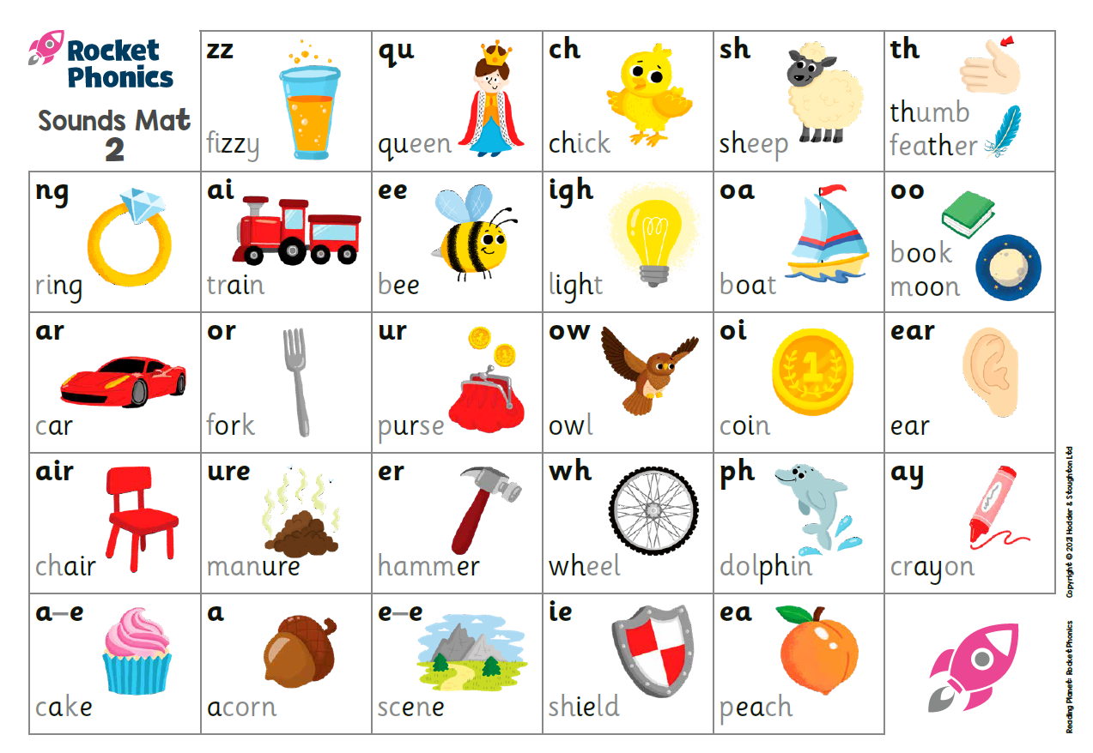
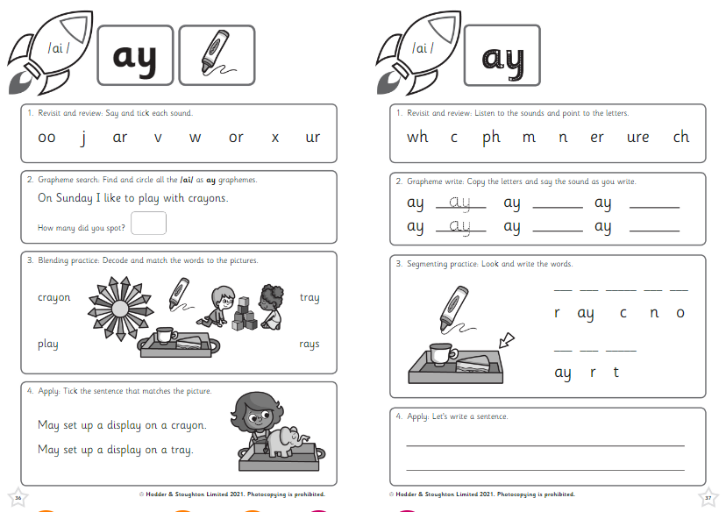
Reading – Rocket Phonics
In school:
1:1 weekly
Guided Reading Sessions
Daily Phonics lesson focusing on new sounds and common exception words.
Introducing Boost
The next generation in digital learning (risingstars-uk.com)
Reading workshop coming soon!

Slide 13
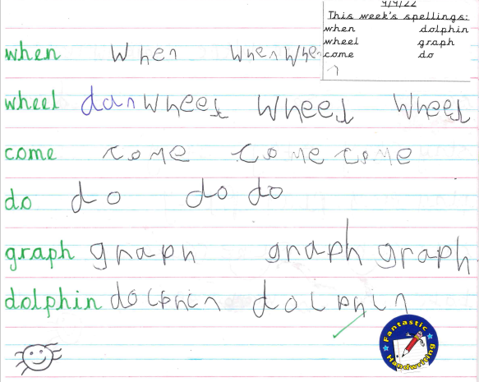
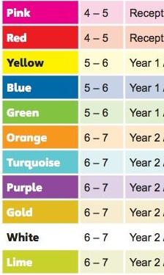
Reading/Spelling
At home
Every child should be aiming to read a school reading book at least 4x a week at home.
Practising their spellings weekly - these will be checked on a Wednesday and new ones sent home.
Coloured Book Bands
Your child will have 2 books on the colour they are reading.
They can also access Rocket Phonics eBooks online.

Slide 14

Reading for pleasure
Share stories
Visit the library
Discuss a range of books
Be a role model
Mystery reader
If you would like to read a book to Hazel Class keep it a surprise!
Book through the office
Each Wednesday at 3pm.

Slide 15

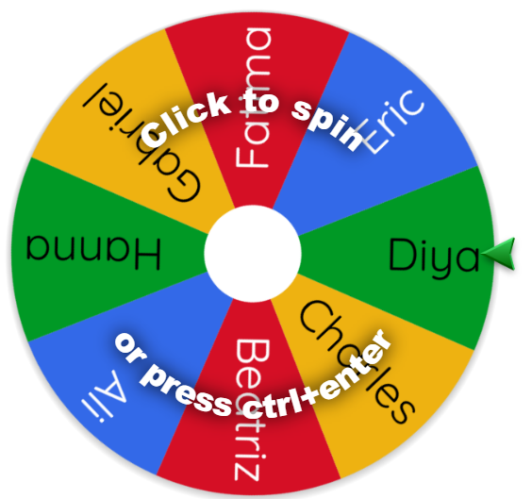



Reading Reward

Slide 16
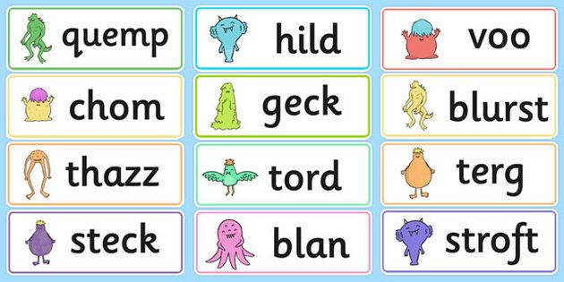
Year 1
Phonics Screening Check
June 2026
Teacher led and completed 1:1
Each child will read 40 words (a mixture of real and nonsense words) from a booklet.
This is a short, light touch assessment to confirm whether individual children have learnt phonic decoding to a standard.
It will identify the children who need extra help to improve reading skills.

Slide 17
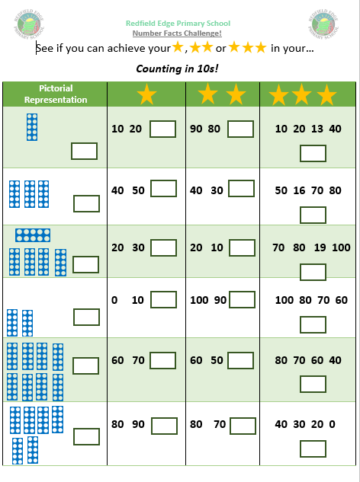
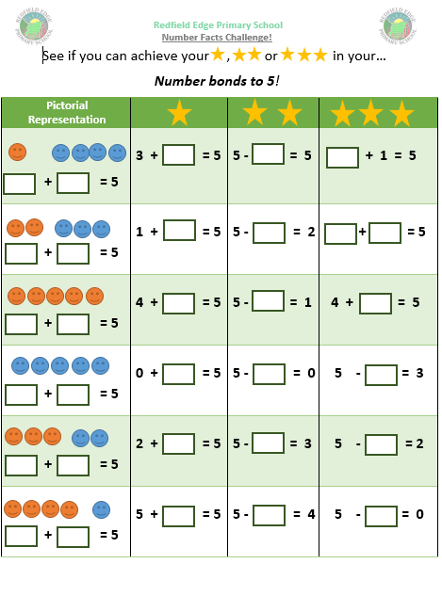




Maths Home Learning
Maths learning at home should be completed 4 times weekly.
This will be recorded in the Reading/Maths Home Learning Book.
4 x Maths Learning a week = 1 House point
This could be timetables, money, telling the time, counting in multiples or anything you feel your child can benefit from!
List of websites:
www.mathsframe.co.uk
www.ttrockstars.com
www.numbots.com
www.maths.co.uk - set by teachers.
Why do Maths Home Learning?
Completing Maths homework consistently will support your child to practise and get better at skills they’re learning in class
It will also reinforce skills that the they may need extra support in.
This will support their fluency in maths learning at home and give them nearly an extra hour of learning time every week for maths.

Slide 18
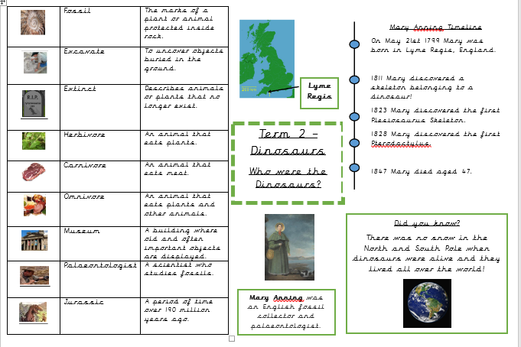
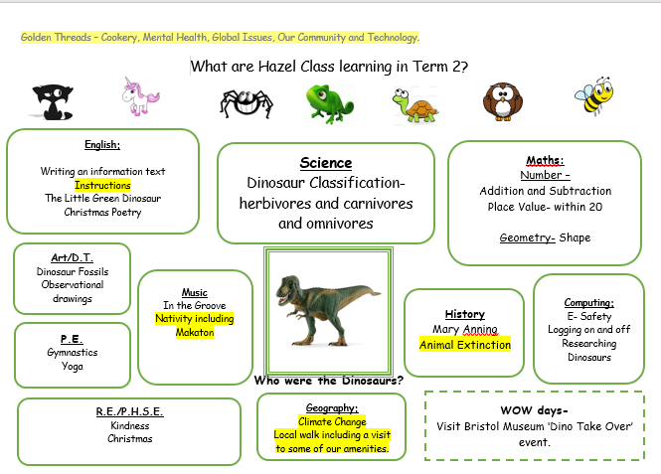
Curriculum Maps and Knowledge Organisers

Slide 19

P.E.
PE is on Tuesday and Thursday afternoons this term.
Every child needs a named PE Kit in school.
P.E. Kit
1. House colour top and black shorts.
2. White trainers or black daps and socks.
3. Children may wear a jumper and trousers when it is cold/rainy, but these must also be black.

Slide 20
Don’t forget
Tuesday and Thursday
PE
Wednesday
New Spellings / homework
Wednesday
Change Books
Mornings
Outdoor Learning Opportunities

Slide 21
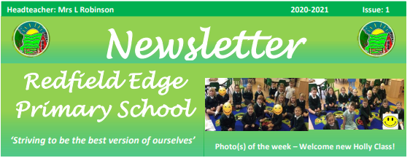
Thank you for listening!
enquiries@redfieldedgeprimary.co.uk

Slide 22

Questions

