Slide 1

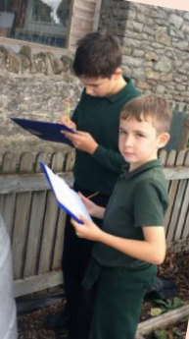
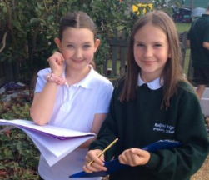
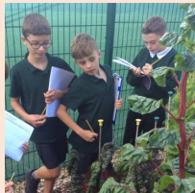
Oak Class Welcome Meeting 2025/26

Slide 2

Mosaic Partnership Trust
We have now been part of the Mosaic Partnership Trust for just over a year now and will be working closely with 11 others schools
on a number of exciting projects to improve our provision here at Redfield Edge.
Networks for leaders in school (HT, DHT, SENDCO)
Networks for subject leaders
Joint training for all staff
Shared resources
Shared expertise
Opportunities for children – sports competitions, music…
Barrs Court Primary
The Park
Parkwall
Ridgeway
Gillingstool Primary
St Michaels Primary
Raysfield Primary
Neston
Box
St Stephen’s Juniors

Slide 3


Behaviour at Redfield Edge
All Mosaic Partnership Trust schools should:
encourage children to treat others as they would want to be treated, with respect and appreciation of difference and diversity
celebrate and reward positive choices of behaviour
provide a safe, secure, reflective and happy environment
believe every individual in the school community needs to take responsibility for their own actions
support through help, encouragement and positive modelling of expectations
accept that mistakes are part of the learning process
respect differences, whether it be race, gender, age, sexuality, religion, disability, socio-economic background or other protected characteristics
value each individual opinion
have a positive atmosphere and 'ethos'.

Slide 4

School Rules
Be Safe
Be gentle and kind
Be co-operative and helpful
Be respectful of others and ourselves
Be responsible
Be honest
Be polite

Slide 5

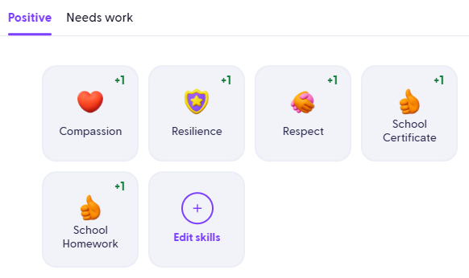
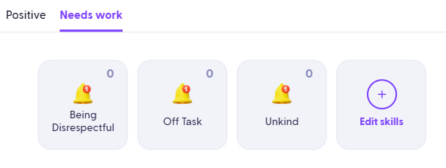
House Points
(Dojos)
Our school behaviour principles and rules remain the same
The behaviour ladder has been removed to reduce the visual element
This change helps avoid feelings of shame for some children
Green Dojos (house points) are awarded for positive choices and go towards each child’s individual house
Both green and red Dojos are monitored closely by staff
A reflection book is after poor behavioural choices to help children understand the real-life consequences of their actions
Repeated poor choices lead to a check-in with a member of SLT
Future aim: share Dojos with parents once a consistent approach across all staff is in place

Slide 6
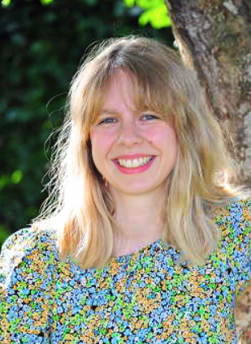
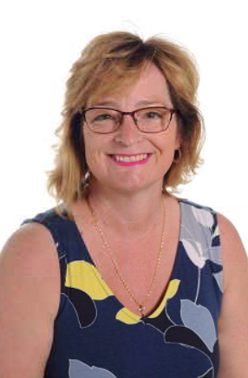
Oak Class Team
Miss Roach
Class Teacher
Mrs Noad Class TA

Slide 7
A typical day in Oak Class
Spellings/morning activity (maths or SPaG)
Reading
English lesson
Play Time
Arithmetic and maths reasoning
Lunch Time
Learning Enquiry
FLEXIBLE GROUPINGS/RESOURCES TO SUPPORT LEARNING IN A VARIETY OF WAYS

Slide 8
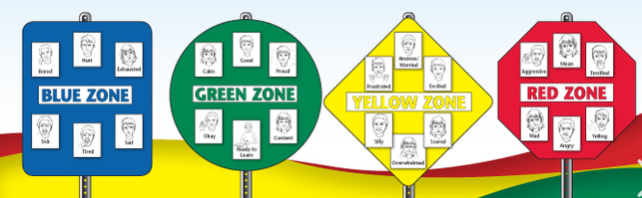
Zones of Regulation
- How are the children feeling?
Recognising their own triggers and learning strategies and ‘tools’
Reflecting on a situation
Support understanding of others

Slide 9
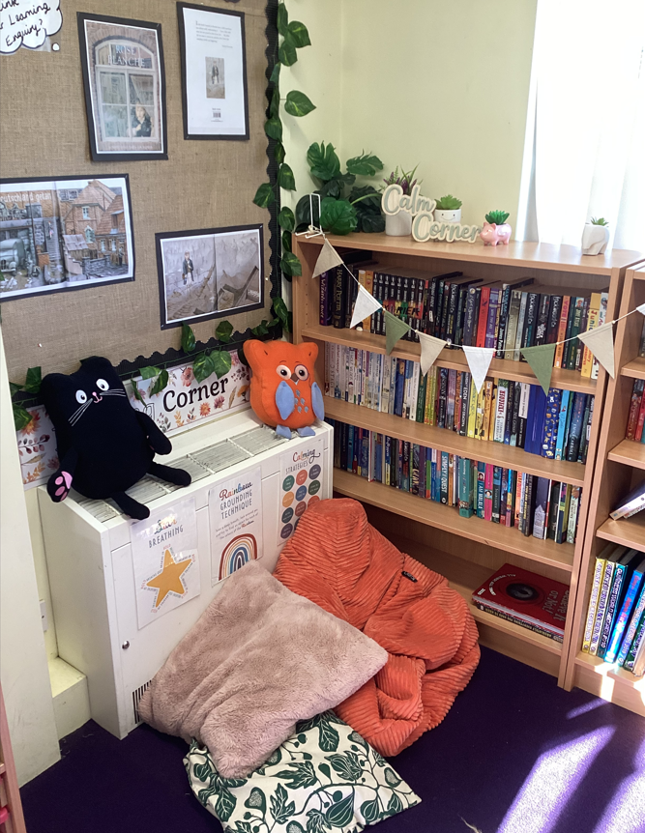
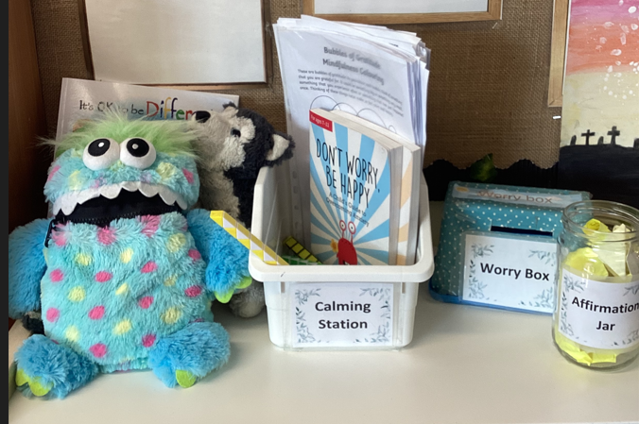

Calming Station

Slide 10
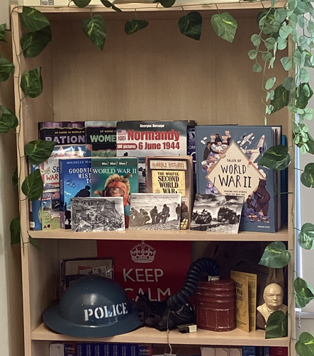
Oak Class Learning Enquiry (topic)
Term 1 – Why was WWII a World War?
Term 2 – How can we innovate?
Term 3 – What was it like to be alive during the reign of Henry VIII?
Term 4 + 5 – What is around and beyond our planet?
Term 6 – Let’s entertain you!

Slide 11



Reading
In school:
Fluency Reading
Extended Read
Close Read
Termly Class text (extended read)
Picture book for English lessons
At home:
4 times a week - to be recorded in reading record.
SPaG.com; Maths.co.uk; Spelling Task
Check Friday – Recorded in records. Rewards for effort.
Any reading activity can be recorded (own books, Nessy)

Slide 12
Writing
Writing for a purpose – Entertain, Inform, Discuss, Persuade
Consolidating key skills (from previous year group to begin with)
Teaching Year 6 SPAG
Try, use, prove sequence.
3 spellings lessons weekly (spelling rules, keywords).
Handwriting practise weekly (part of a spelling lesson - cursive).

Slide 13
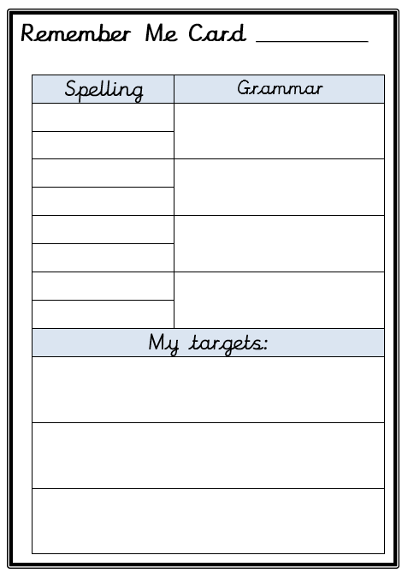
English Targets
Spellings
Punctuation
Grammar
Handwriting

Slide 14
Maths
In school
Entry quiz to assess at start of new unit
Learn, use, explore sequence
Arithmetic lessons (place value, calculation, FDP)
Resources used to support learning

Slide 15




Maths Home Learning
Maths learning at home should be completed 4 times weekly. Set maths.co.uk task.
This will be recorded in the reading record books
4 x maths Learning a week = 1 House point
This could be timetables, money, telling the time etc
Why do maths home learning?
Completing maths homework consistently will support your child to practise and get better at skills they’re learning in class.
It will also reinforce skills that the they may need extra support in.
This will support their fluency in maths learning at home and give them nearly an extra hour of learning time every week for maths.

Slide 16
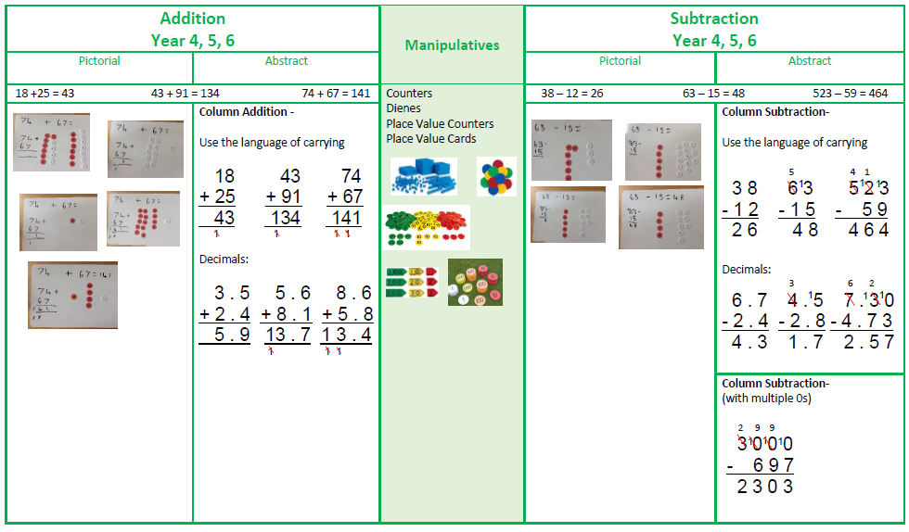
Maths
School calculation policy – if helping/supporting your child at home, where possible we would encourage using the same methods to ensure continuity in the use of their methods.

Slide 17
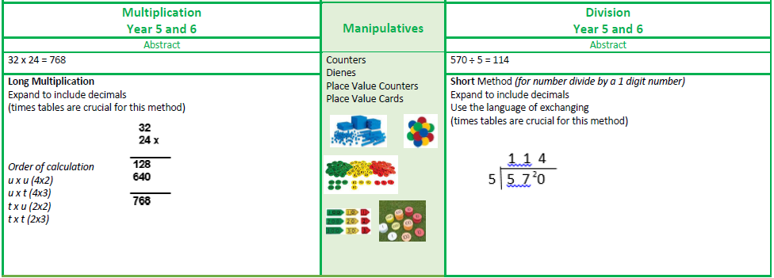
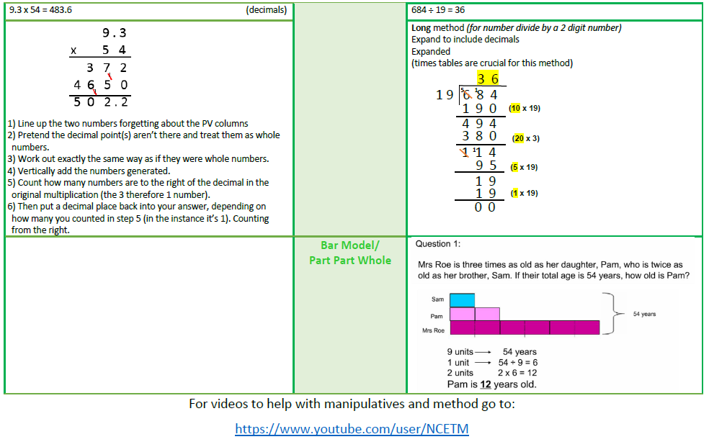

Slide 18
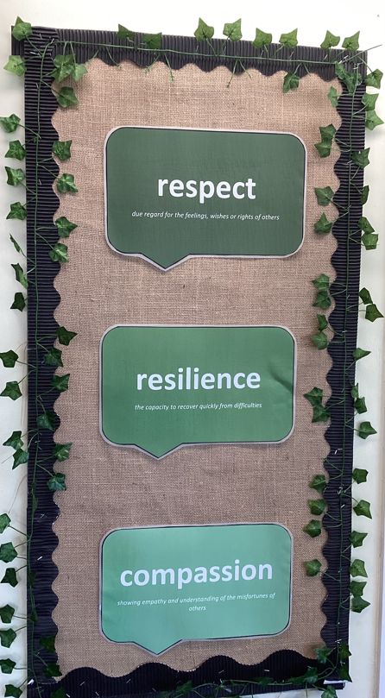
Values
‘Striving to be the best version of ourselves’
Golden Threads:
Community
Global Issues
Information Technology
Mental Health
Life Skills

Slide 19
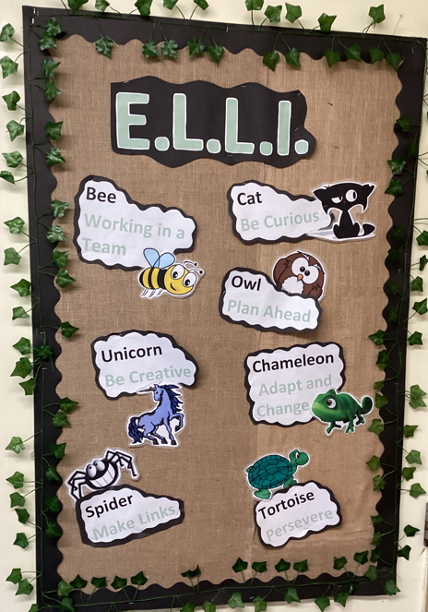
Learning Styles - ‘ELLI’

Slide 20
How Parents Can Help
Reading –
Read to your child, share stories, encourage reading for pleasure, join a library, read books that are enjoyable.
Encourage reading with expression and comprehension (answering questions in full sentences).
Maths -
Help children apply their maths skills (handling money and giving change, telling the time, measuring and solving real life problems, time tables)
Continue to practise times tables.
English -
Weekly spelling activity linked to classroom learning.
SPaG weekly tasks to practise.

Slide 21

Other Information
Water bottles
Bathroom visits
P.E – Wednesday & Thursday (can change termly)
Open classrooms – scheduled throughout the year
Extra-curricular clubs
Class assembly – Thursday 9th October
Camp

Slide 22

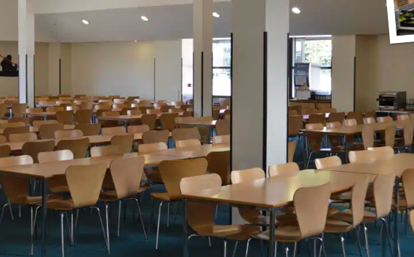
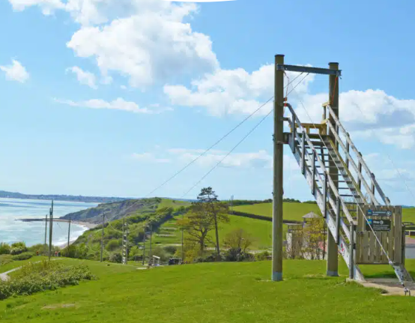
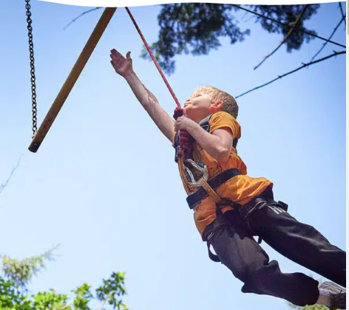
Y6 Camp
March/April 2025
There will be a meeting about this later in the year, usually around March.
Following information will come from the office.

Slide 23

Questions - If you have any queries/concerns/questions at any point during the year, please let us know!!
Enquiries@redfieldedgeprimary.co.uk
Keep up to date with events/learning in the…..
On ‘X’
@OakClass_RE

Slide 24


