Slide 1

Welcome to Pine Class

Slide 2
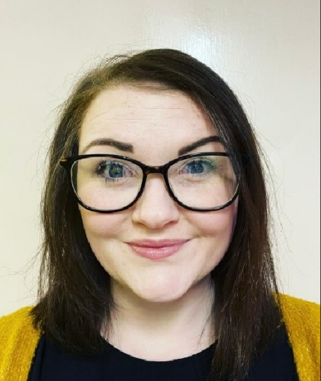
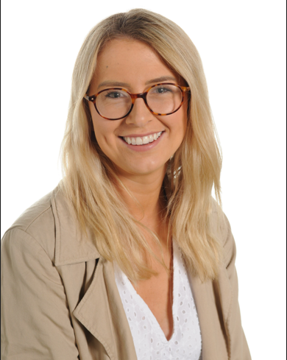
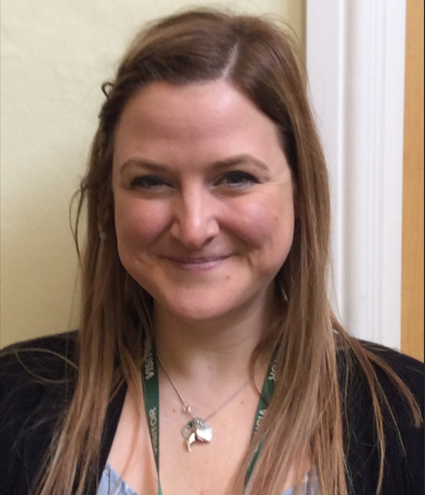
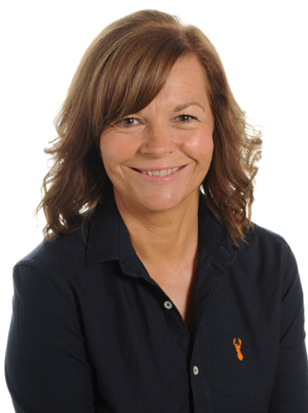
Meet The Team
Miss Kelly
Class Teacher
Monday, Tuesday and Friday
Ms Philips
Class Teacher
Wednesday and Thursday Morning
Mrs Williams
HLTA Teaching Assistant
Thursday Afternoon
Miss Arnold
Teaching Assistant and 1:1 support
Every Morning

Slide 3
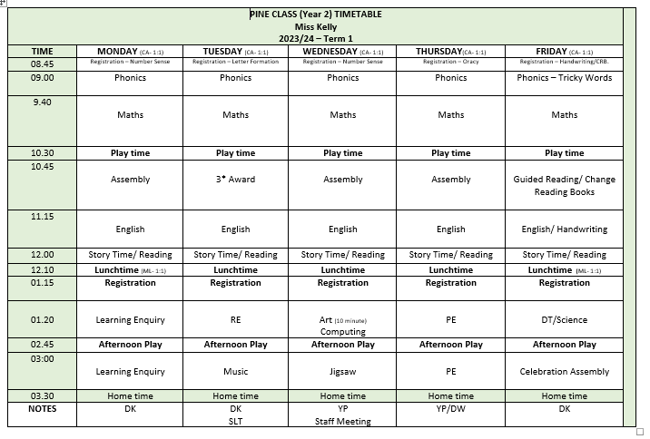
Routine

Slide 4
Playtime and Lunchtime
Morning Playtime 10:30- 10:45
Children have the choice of a healthy snack or toast and milk if paid for in advance.
Lunchtime 12:15- 1:15
Children go into the hall at 12:15 and eat either packed lunch or hot dinner.
When they finish eating, they go outside and play until 1:15.
Afternoon Playtime 2:30- 2:40
Children are offered fruit from the classroom.
Year 2 will join KS2 outside for a playtime.

Slide 5

P.E.
PE is on Thursday afternoon this term. Every child needs a named PE Kit in School.
P.E. Kit:
1. House colour top and black shorts.
2. White trainers or black daps and socks.
3. Children may wear a jumper and trousers when it is cold/rainy, but these must also be black.

Slide 6





Independence:
Please name your child’s
water bottle, cardigans, jumpers etc!

Slide 7





Teaching and Learning
Children need to learn how to learn!
We will be continuing to encourage the children to develop the following skills:
Owl
Strategic Planning
Spider
Links in Learning
Bee
Team Work
Chameleon
Changing Learning
Cat
Curiosity and
Questioning
Unicorn
Creativity
Tortoise
Resilience

Slide 8

Mental Health
and Wellbeing
Golden Thread
Large focus in term 1
Zones of Regulation
Metacognition- learning to learn
Mindfulness
Mental Health Ambassadors
Sensory Room

Slide 9

Rules and Expectations
Exceptional behaviour (text sent home)
Behaviour Chart
Shown good behaviour all day
Shown some good behaviour
Well behaved
Verbal warning
2 minutes reflection time
5 minutes reflection time
(text sent home)

Slide 10
Values and Threads
House Points
Values:
Ambition
Mindfulness
Honesty
Resilience
Compassion
Thankfulness
Respect
Curiosity
Golden Threads:
Community
Mental Health
Life Skills
Global Issues
Technology

Slide 11
Topics
Term 1: What was life like in a castle?
Term 2: Who was Florence Nightingale and why is she important today?
Term 3: Where in the world would you go?
Term 4: What happened during the Great Fire of London?
Term 5: What’s at the bottom of your garden?
Term 6: Do you like to be beside the Seaside?

Slide 12
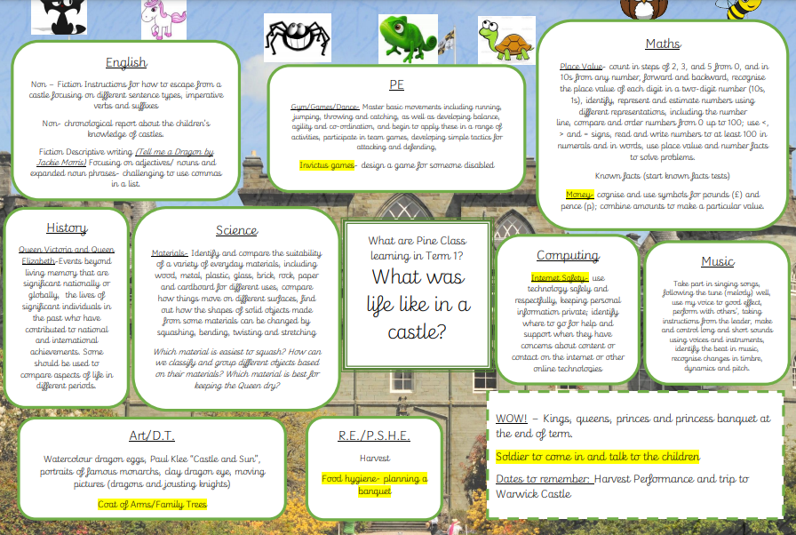
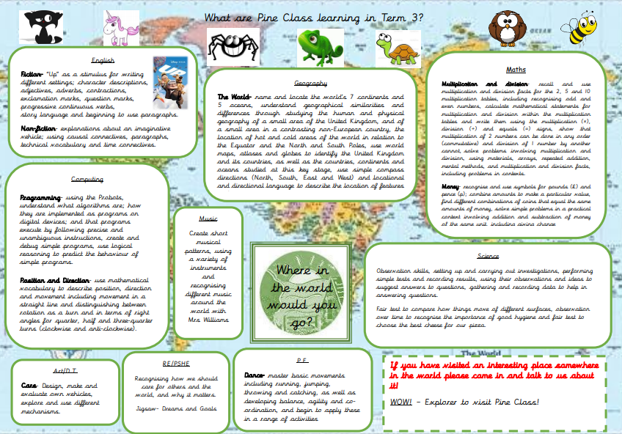
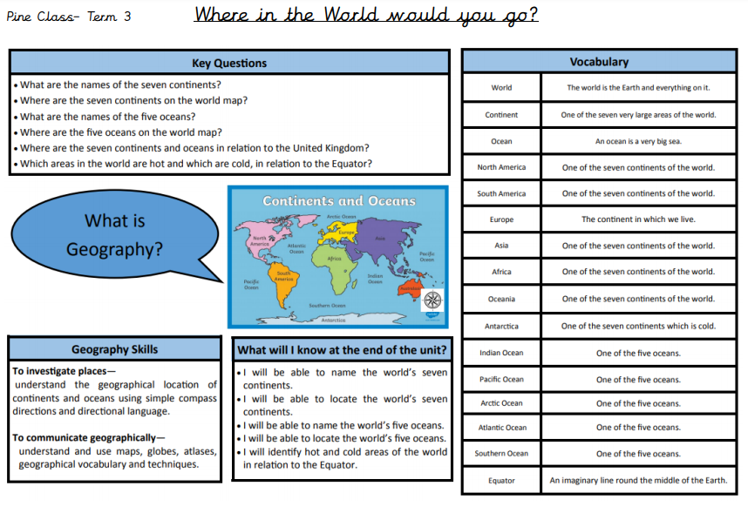
Curriculum Maps and Knowledge Organiser

Slide 13
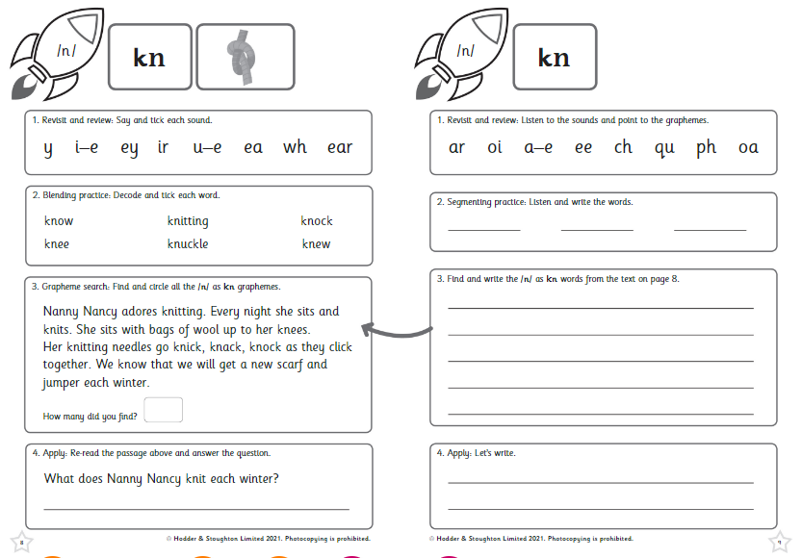
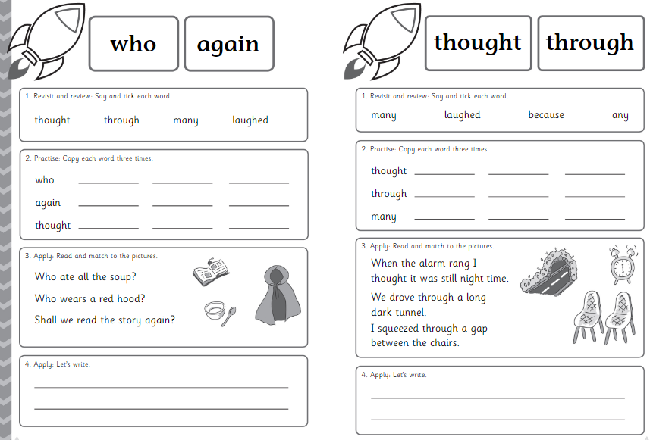
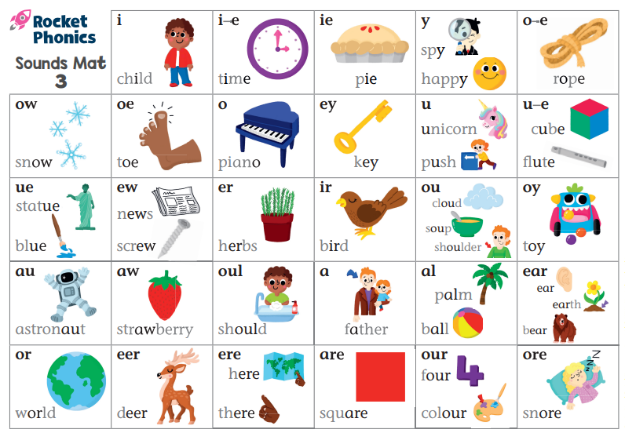
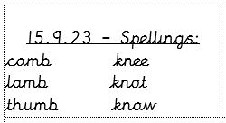
Phonics and Spellings

Slide 14

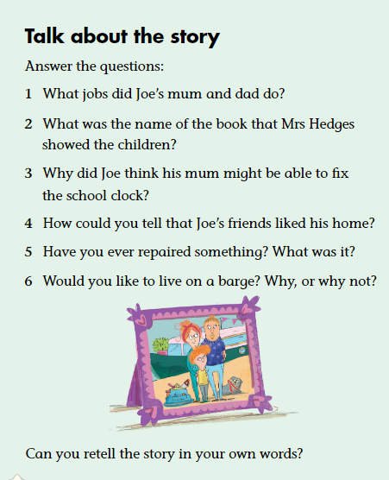
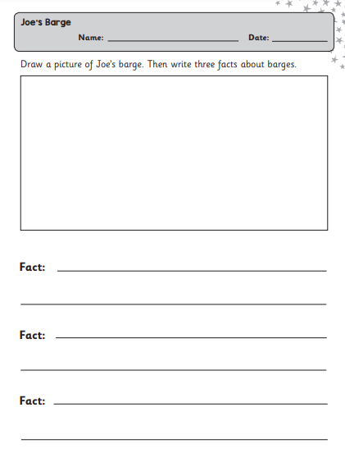
Guided Reading

Slide 15
Reading
In school:
Guided reading
Vocabulary, Inference, Predict, Explain, Retrieve and Sequence.
Focus on comprehension skills focusing on retrieving information and being
able to understand and discuss what is being read.
Library and Reading for Pleasure
The children read independently in class every day as well as listening to our class book read aloud.
They are also given the opportunity to change their book at least once a fortnight in the library.
Reading Assistant
A select few children will be listened to. These are children who need extra support in reading comprehension.

Slide 16
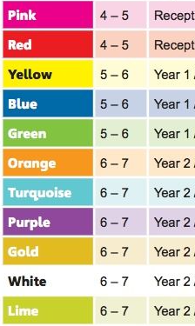
Reading
At home:
Every child should be reading a school reading book at least 4 times a week at home
Coloured Book Bands
Your child will have 2 books on the colour they are reading.
These books can be changed on a Friday but I suggest children read the book at least twice before changing.
They are also allowed to read books from home and this can be recorded in their Reading Record Book.
If they read 4 times they earn a house point.

Slide 17
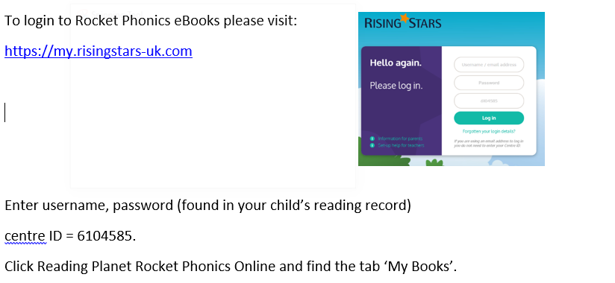

Rocket Phonics eBooks

Slide 18


Maths
At home:
Number Bonds and Times Tables
Practise 4 times a week.
This can be on Numbots, TT Rockstars or on paper either with an adult/seen by an adult.
Activity must be recorded in home learning record.
This will support their fluency in maths learning at home and give them an extra hour of learning time every week for maths.

Slide 19
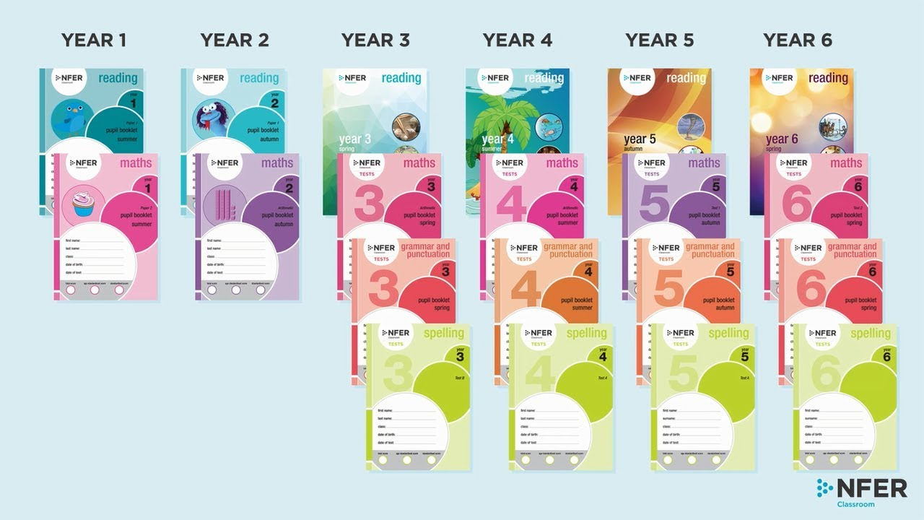
Assessments

Slide 20
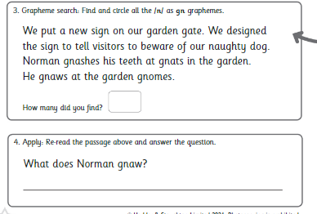
Assessments

Slide 21
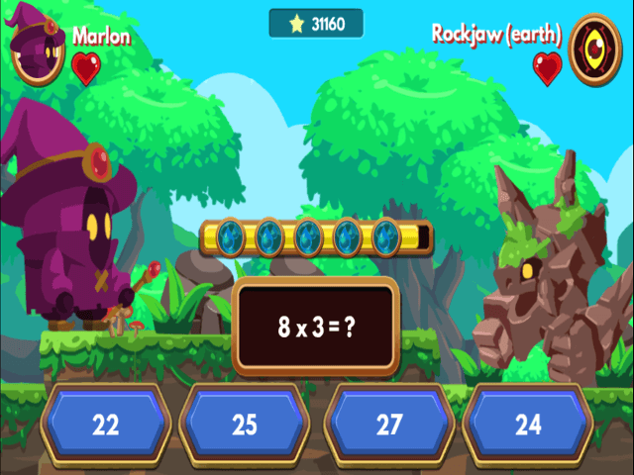

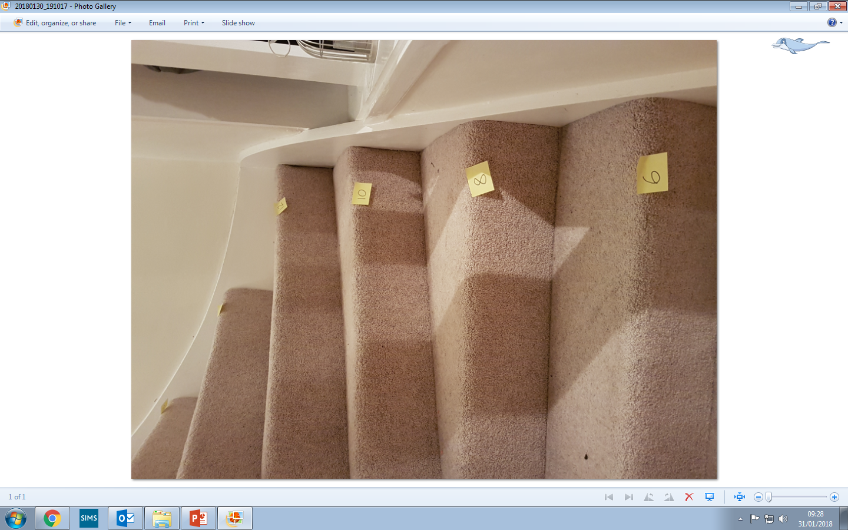
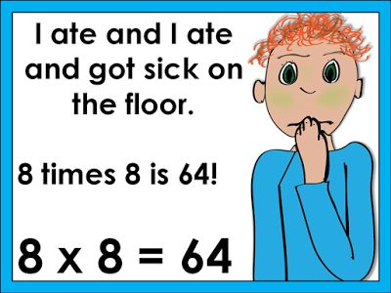


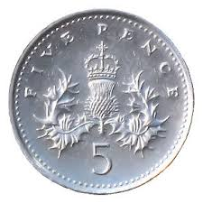
How can you help at home?
Maths Frame
Top Marks
TT Rock Stars
Numbots
Musical Maths
Activity Booklets
Rhymes
Counting in 2s, 5s and 10s

Slide 22

Don’t forget to follow us on Twitter!
@PineClass_RE2

Slide 23

Questions

