Slide 1
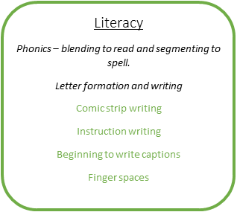
Animals, habitats and superpowers continued… What are Holly Class learning in Term 4?
Communication and Language
C
Oracy sessions – odd one out, reasoning why do you think…, answering why and ‘how would you feel if’? questions.
Waiting for a turn to speak – still a big focus for our class!
Personal Social Emotional Development
Jigsaw scheme – Healthy Me – Links to Physical Development (see below)
Taking turns and negotiating problems
Independence and resilience
Personal organisation and RESPECTING THINGS ☺
C
Maths (direct teaching)
Counting – cardinality, strategies, counting out of a larger group, counting objects that cannot be moved
Comparing numbers up to 8, then 9 and 10.
Doubles
Physical Development:
Gross Motor: Develop overall body-strength, balance, co-ordination and agility.
REAL PE every week. Trim Trail opportunities. Using the field for gross motor activities.
Fine Motor: Targeting pen grip, Fine Motor area weekly activities
Know and talk about the different factors that support their overall health and wellbeing: regular physical activity, healthy eating, toothbrushing, sensible amounts of ‘screen time’,
having a good sleep routine, being a safe pedestrian.
C
Understanding the World
Understand the effect of changing seasons on the natural world around them.
Noticing Spring
Planting
Easter
Beebots
Expressive Arts and Design
Exploring a range of media and materials, refining methods
C
Collage
Joining materials
Printing with vegetables
Building outside – construction area
Golden Threads: Community/ Mental Health/ Life Skills/ Global Issues/ Technology

