Slide 1

Welcome to Holly
Please label your children's clothes/water bottles/ lunch boxes!!

Slide 2
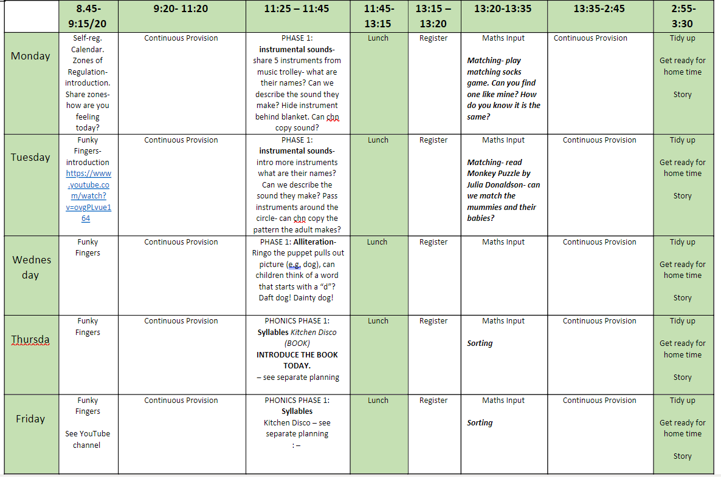
Routine

Slide 3
Sharing your child's learning
Evidence Me – app. You should have received a letter about this and given/ not given permission here – any questions? This will not be every week! Focus children talk about...
Twitter – once every few weeks something will be posted, like a summary of learning, more general.
Newsletter
Invite parents in! Themed weeks (e.g. arts week), parents evenings. Catch us on the gate - seems busy but always happy to be caught once all children have gone safely.
WE CANNOT DO THIS WITHOUT YOU GUYS! You know your child best and you are their primary caregivers, we need and want you on board, joining in with any homework's we set and just generally showing interest!

Slide 4

Reading
In school:
1:1 reading with the teacher or TA weekly.
Daily Phonics Lesson:
Focusing on 2 new sounds a week, and a day focussed on Common Exception Words.
Myself and Miss Kelly will be running a parent workshop on reading/ phonics soon and will circulate date asap.
Please have a look at this list below and see if you can incorporate some of these at home.
Rhythm Able to follow and copy a tapped out rhythm (instrument or body) | Rhythm Able to create own rhythm to be copied | Rhyme Able to find the rhyming pairs in familiar objects (CVC words i.e. cat/hat | Rhyme Able to continue a rhyming string Starter word- cat Children generate string- cat, hat, fat, rat… | Alliteration Able to match objects by initial sound | Alliteration Able to hear the initial sound in own name | Alliteration Able to hear initial sounds in familiar objects | Blending Able to blend segmented sounds i.e. c-a-t= cat and select matching object | Segmenting Able to segment sounds in CVC object/ word i.e. cat = c-a-t

Slide 5

Reading/Spelling
At home:
Every child should be reading a school reading book at least 3-5 times a week at home
Practising their CEW – later on in the year these will be in reading records.
Book Bands
You will start to get Lilac books next week! This is to get into routine, start getting your child ready for reading, develop language skills in specific way, etc.
Your child will have a book, linked to the sounds they have learnt in school.
These books will be changed as your child reads with an adult.

Slide 6
Writing/ Mark Making and Fine Motor Development
Please do do those fine motor skill activities (or any other of your own) as frequently as you can!
If your child is in need of extra support here we will mention it to you specifically at
Parents Evening.
Tues 8th Thursday 10th November.
Want it to be meaningful and purposeful!
Get them involved in writing lists for shops, thank you cards for gifts they receive, etc.
Lots of praise and encouragement at this stage!

Slide 7

Maths
Homework!!
This term we are focusing on 1-3, and then up to 5. Please take your child on a walk, in nature and just focus on noticing what is around you. Take some photos of '3, or not 3'. Then play a game!
At home:
Subitising – what is this?
Home learning maths – will send out ideas.
Numbots later in the year.
https://www.youtube.com/watch?v=4KtifCNlYy4

Slide 8
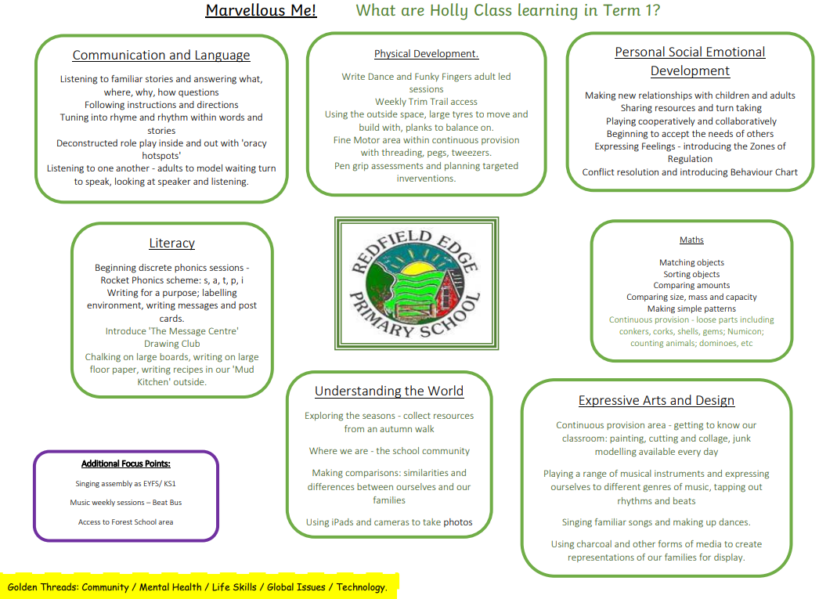
Curriculum Maps
CHECK OUT WEBSITE

Slide 9
Values and Golden Threads
Values:
Ambition
Mindfulness
Honesty
Resilience
Compassion
Thankfulness
Respect
Curiosity
Golden Threads:
Community
Mental Health
Life Skills
Global Issues
Technology

Slide 10



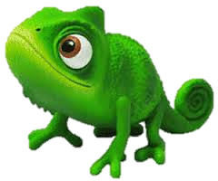

Teaching and Learning
Children need to learn how to learn!
We will be continuing to encourage the children to develop the following skills:
Owl
Strategic Planning
Spider
Links in Learning
Bee
Team Work
Chameleon
Changing Learning
CERTIFICATES
Cat
Curiosity and
Questioning
Unicorn
Creativity
Tortoise
Resilience

Slide 11

Mental Health and Wellbeing
Golden Thread
PSED huge focus for us across the year
Zones of Regulation
Mental Health Ambassadors
Hello Yellow- watch this space!

Slide 12
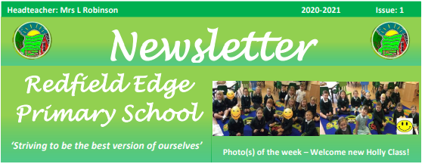

Thank you for listening!
Don’t forget to follow us on Twitter.
@HollyClass_RE
enquiries@redfieldedgeprimary.co.uk

Slide 13

Questions

