Slide 1
Helping my Child at Home with Maths

Slide 2
Why?
Develop core skills
Use and apply them in EVERY maths lesson
Foundations which are built on in class
May find maths challenging as they can’t draw on these core skills.

Slide 3
Record Book

Slide 4
Tracking

Slide 5
How to Teach Times Tables
May not be the same as you learnt them
You may have struggled as you were only taught one way
Need to find out which way helps/works for your child

Slide 6
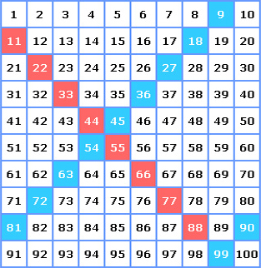
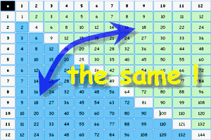
How to Teach Times Tables Patterns
Commutative Law

Slide 7
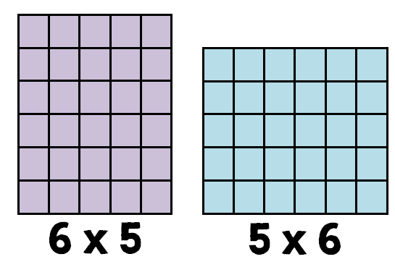
How to Teach Times Tables Patterns
6 lots of 5 5 lots of 6

Slide 8
How to Teach Times Tables Patterns/tricks
x 2
Always even
Doubling
x 5
5
10
15
20
25
30
35
x 11
11
22
33
44
55
66
77
x 9
Hands
Add tens - subtract ones
x 6
Double 3s
x 12
x10 x2 add together
e.g. 12 x 7 = 84
10 x 7 = 70
2 x 7 = 14
70 + 14 = 84
x 8
Double 4s

Slide 9
How to Teach Times Tables Movement
Marching
Actions (punching / karate / YMCA)
Blue tack/ Post it notes on stairs to march up and down to

Slide 10
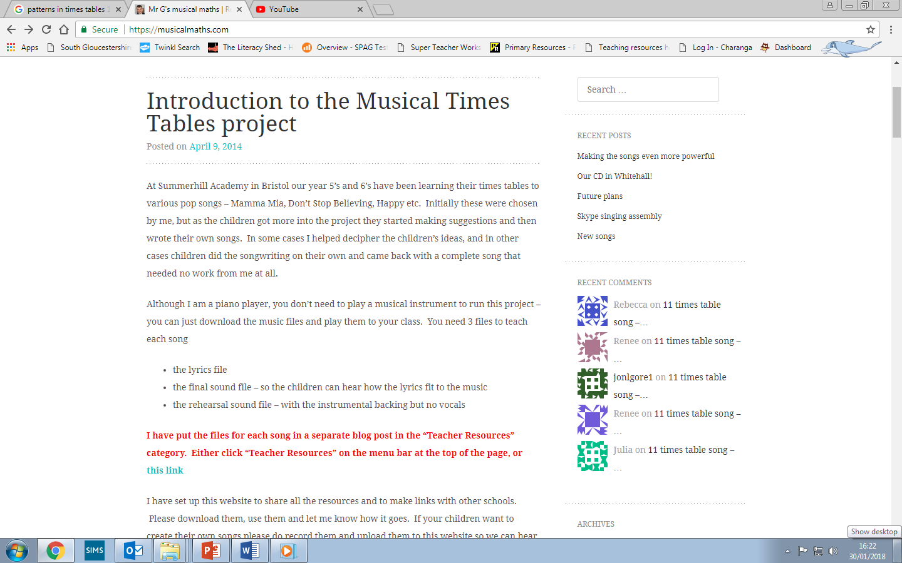
How to Teach Times Tables Songs – Musical Maths
www.musicalmaths.com

Slide 11
_ _ _ 1 times 8 is 8
_ _ 2 times 8 is 16
_ _ _ And 3 times 8 is
24
_ _ 4 times 8 is 32
_ _ 5 times 8 is 40
_ _ _ And 6 times 8 is
48
7 eights are 56
_ _ 8 times 8 is 64
9 times 8 is 72
10 eights are 80
_ _ 11 eights are 88
12 times eight is 96
INTRO → REPEAT THE SONG
GUITAR SOLO
Don’t stop singing
Use your 8 times ta---bles
Now that you know it
Come and si------ng
(Sing this bit x2)
Don’t stop

Slide 12
How to Teach Times Tables Songs – You Tube
Searching any times table on You Tube
www.youtube.com/watch?v=uvqTizEfrhU

Slide 13
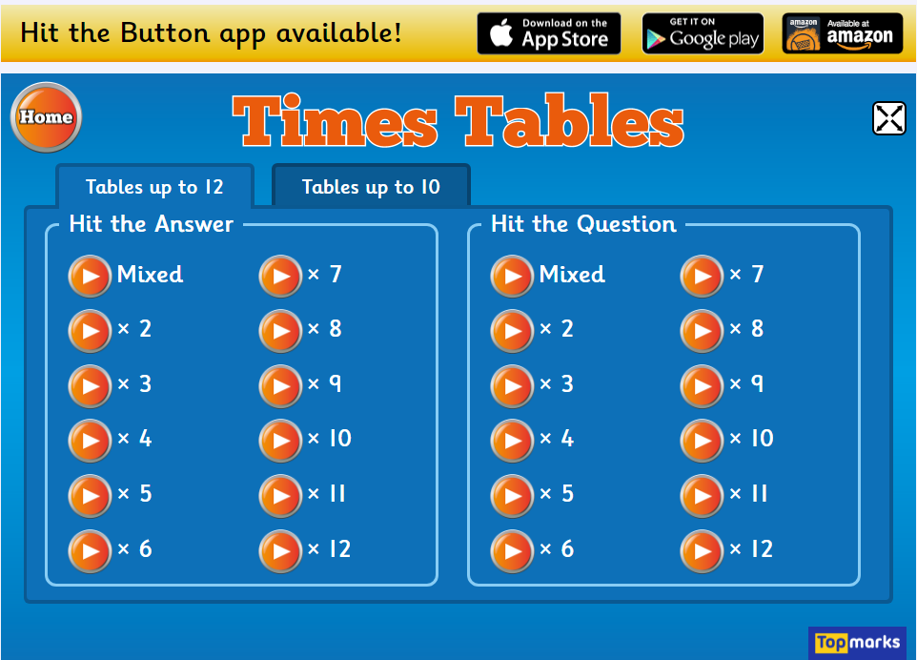
How to Teach Times Tables Online Games
Just by searching “times table games” you will find hundreds of sites
www.topmarks.co.uk/maths-games/hit-the-button
www.bbc.co.uk/skillswise/game/ma13tabl-game-tables-grid-find
www.topmarks.co.uk/maths-games/7-11-years/times-tables
www.crickweb.co.uk/ks2numeracy-multiplication.html

Slide 14
How to Teach Times Tables Prodigy Maths

Slide 15
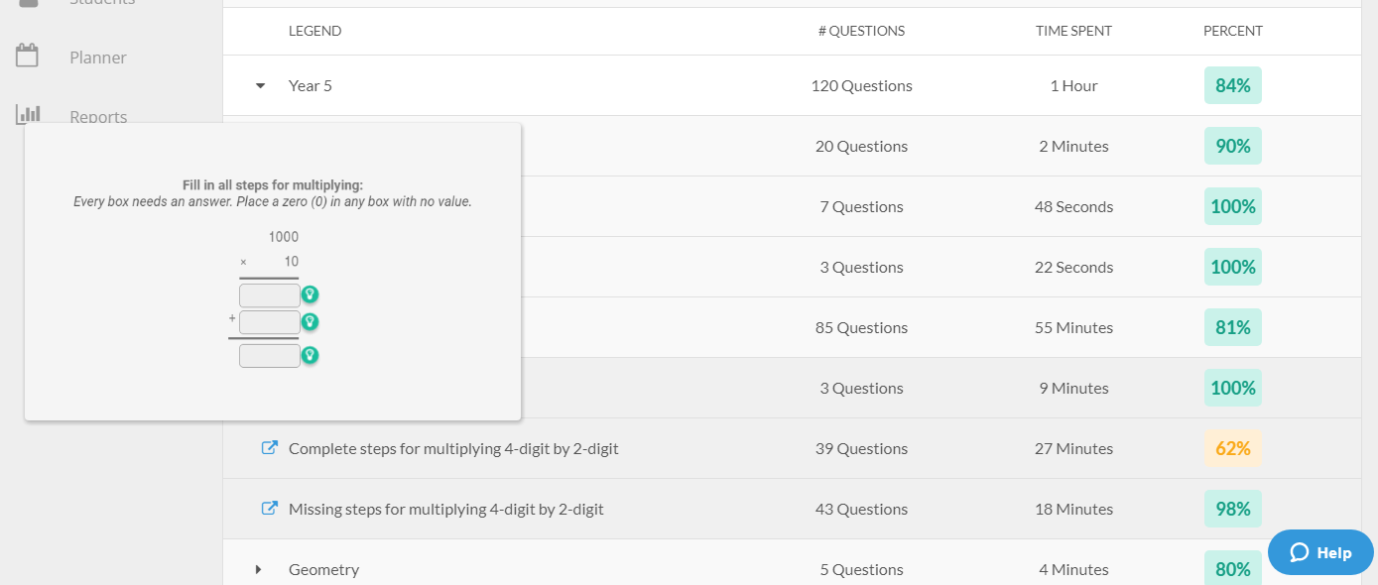
How to Teach Times Tables Prodigy Maths

Slide 16
How to Teach Times Tables Prodigy Maths

Slide 17
How to Teach Times Tables Prodigy Maths
Pros
Self evaluates
Pitches at your child’s level
No input needed
Whole curriculum
Fun interactive game
Feedback to teacher
Feedback to connected parents
Cons
If children get something right, it will move on to more complex skills
Inputting answers
Not specific to times tables
American
Overcoming the Cons
Support but don’t do
Jotter / scrap piece of paper
Use it as well as other activities

Slide 18
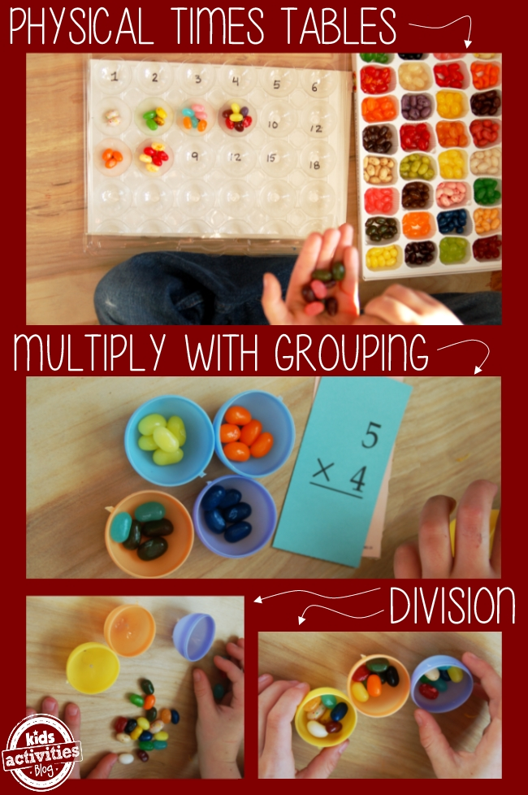
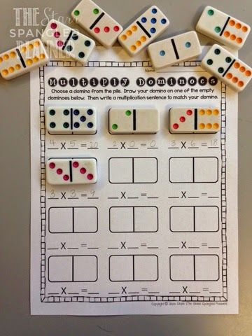
How to Teach Times Tables Games
Snap
Bang
Flash Cards

Slide 19
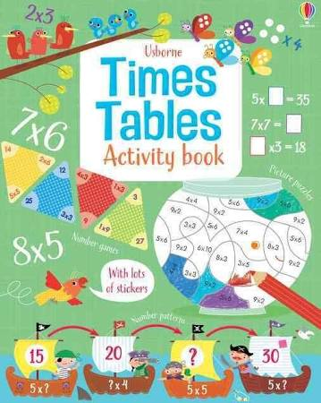
How to Teach Times Tables Activity Booklets
Lidl
Asda
Marks and Spencer's
WH Smith

Slide 20
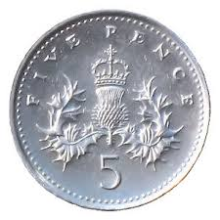
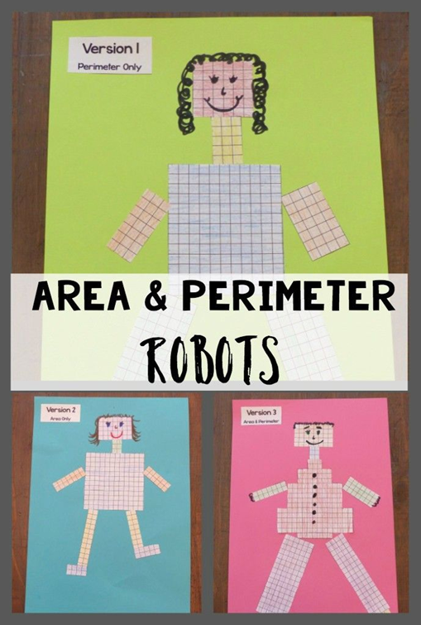
How to Teach Times Tables Purpose
Can you afford this? etc

Slide 21
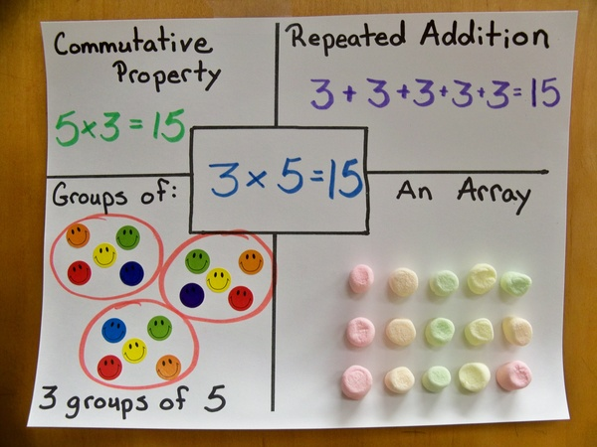
How to Teach Times Tables Links
Repetition 1 to 12 12 to 1
Starting from x5
www.youtube.com/watch?v=yXdHGBfoqfw

Slide 22
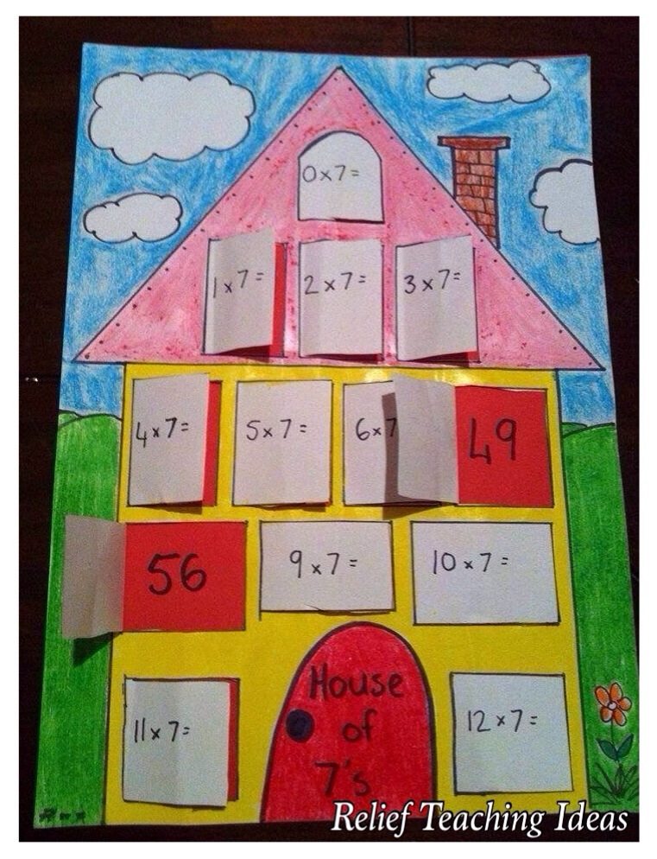
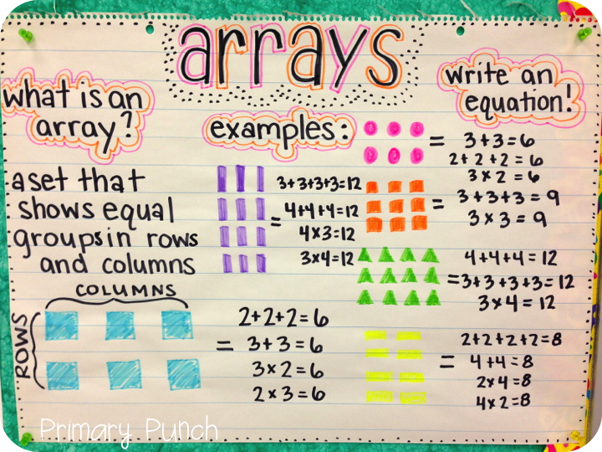
How to Teach Times Tables Posters
Making their own posters
Put them up in a prominent place

Slide 23
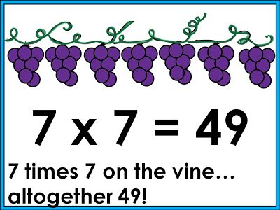
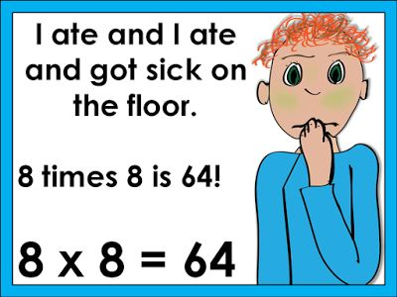
How to Teach Times Tables Rhymes

Slide 24
Starting to develop the skills early on
Notes:
2nd one as this enables the children to apply to different calculations without calculating by relying on their understanding.

Slide 25
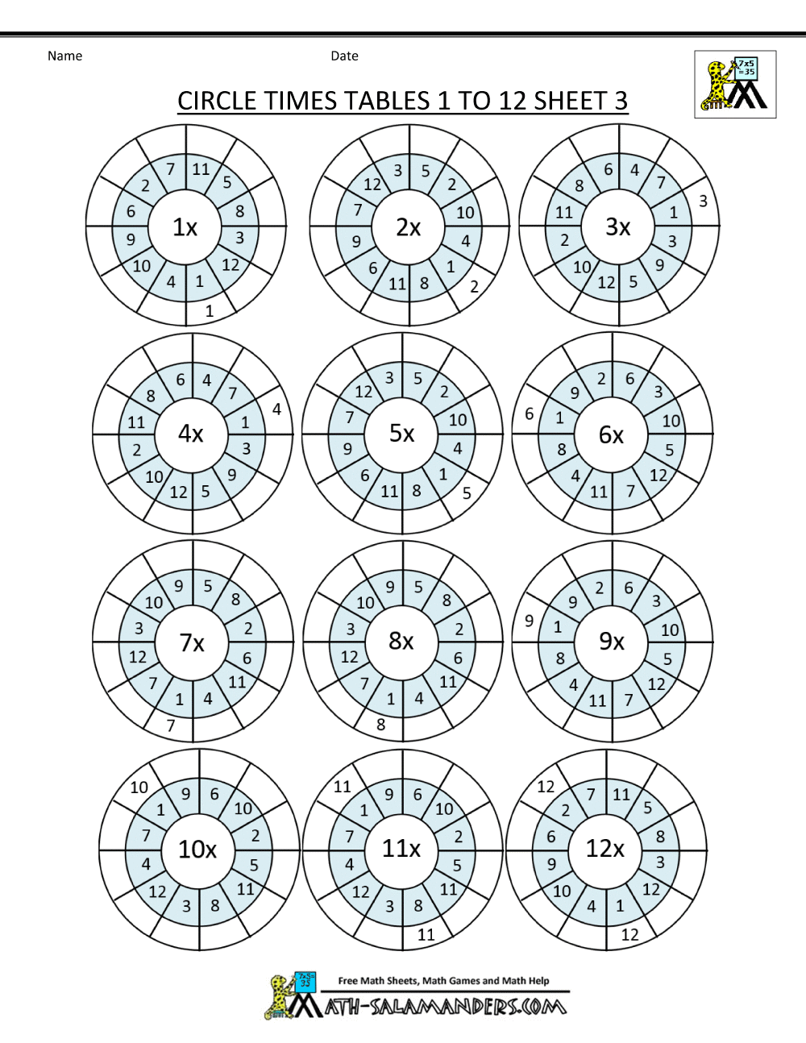
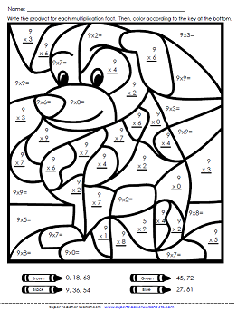
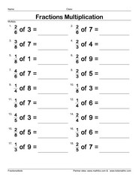
How to Teach Times Tables Activities – google!

Slide 26
Multiplication Triangles
12
108
÷
÷
÷
÷
÷
÷
4
x
3
x
12
5
x
6

Slide 27
Name The Section
 | Multiple of 10 | Not a multiple of 10
Multiple of 20 | A | B
Not a multiple of 20 | C | D
Name the section into which each of these numbers would go:
80,50,200,55
What is the largest 3 digit number that would fit in section A,C,D
Which section can never have any numbers in ? Why?
Describe the sort of number that would go into section C.

Slide 28
Different Calculations but Same Answers
A | B | C | D | E
3X3 | 7X2 | 24÷6 | ½ of 16 | 36÷4
50/2 | 3X9 | 36÷3 | 41-14 | 16+10
17+18 | 4X9 | 64/2 | 7X5 | 50-12
26+21 | 60-11 | 9X7 | 54÷7 | 7X7
0.5+0.2 | ½+ ¼ | 1-1/8 | 0.25x3 | 3/10+1/2

Slide 29
Divisible by 2
Divisible by 3
14 | 75 | 12
24 | 98 | 125
25 | 110 | 30
45 | 150 | 100
51 | 342 | 256
65 | 360 | 123
70 | 831 | 225
3. Using the divisibility tests, place each number in the Venn Diagram
What do you notice about the numbers in the parts where the circles overlap?
Divisible by 5

Slide 30
3. Using the divisibility tests, place each number in the Venn Diagram
Divisible by 2
Multiples of 6
Divisible by 3
51
14
24
14 | 75 | 12
24 | 98 | 125
25 | 110 | 30
45 | 150 | 100
51 | 342 | 256
65 | 360 | 123
70 | 831 | 225
123
342
256
12
98
831
360
30
110
150
75
70
100
225
45
Multiples of 10
Multiples of 15
65
25
Multiples of 30
125
What do you notice about the numbers in the parts where the circles overlap?
Divisible by 5

Slide 31
How to Teach Times Tables Final ideas
Learn it with them
Joke about them – personal
drip drip drip

Slide 32
Growth Mindset

Slide 33
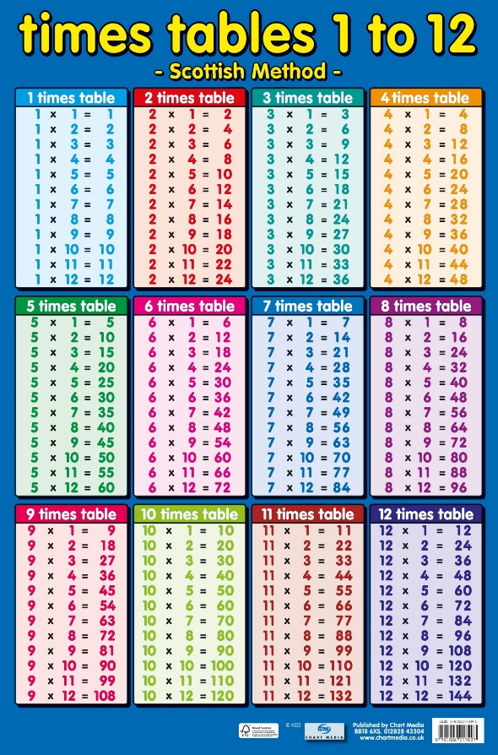
In Your Packs
Times Table Poster
Multiplication Grid (filled)
Multiplication Grid (empty)
100 Square
White Board
White Board Pen
White Board Rubber
Array of Games

Slide 34
Questions and Feedback Forms

